Slide 1
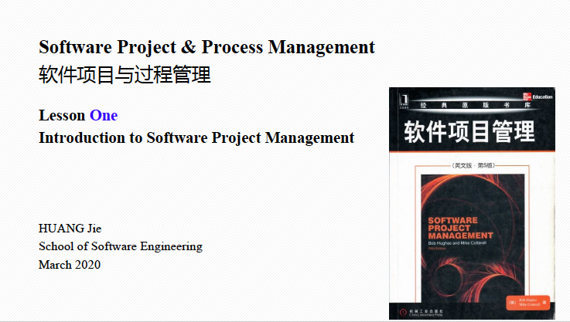
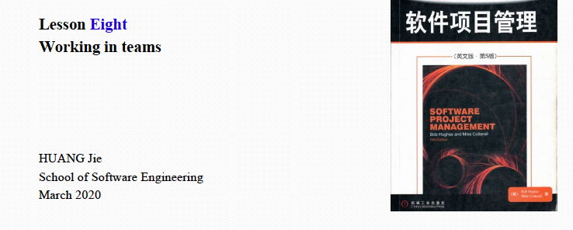
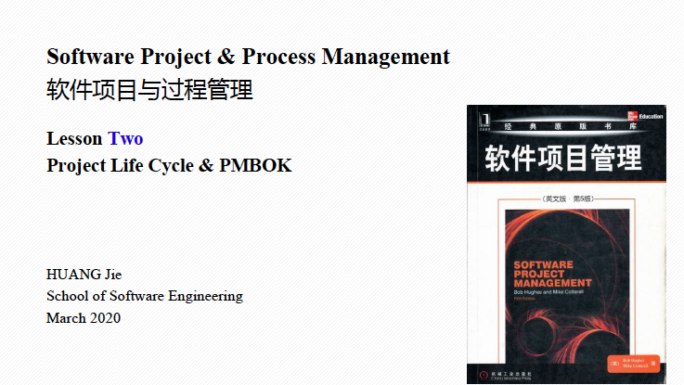
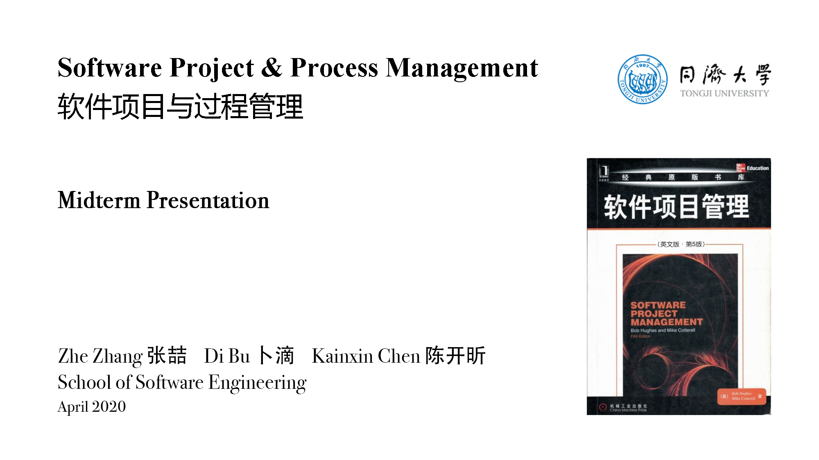
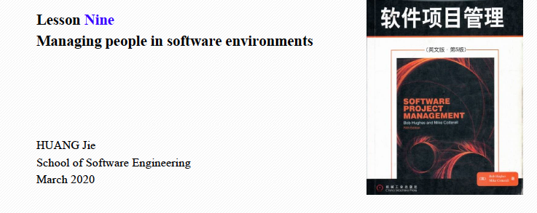
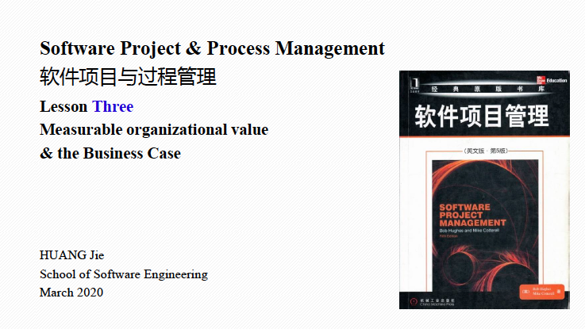
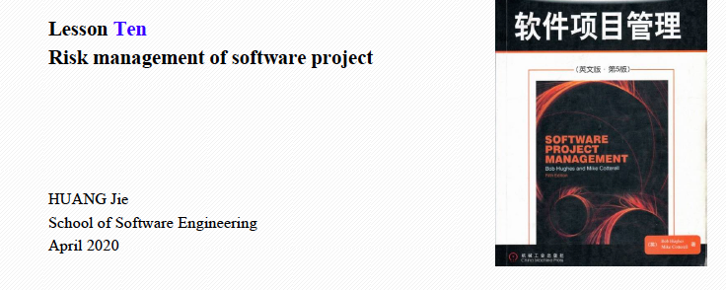
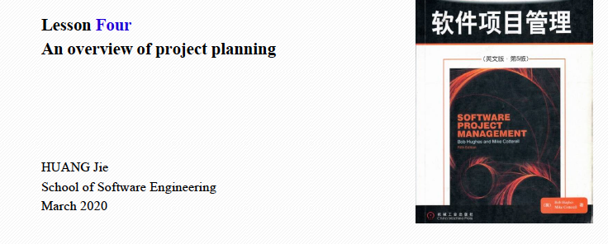
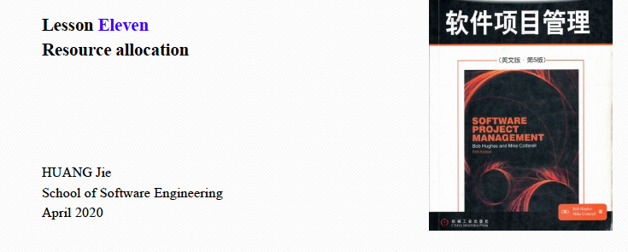
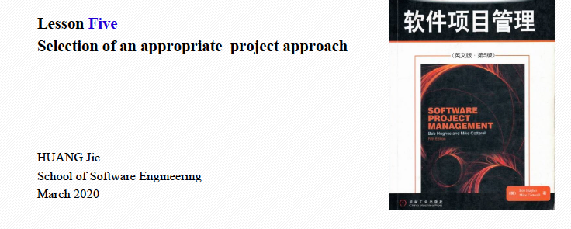
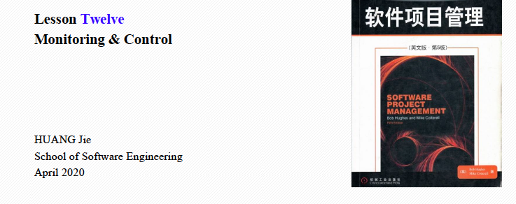
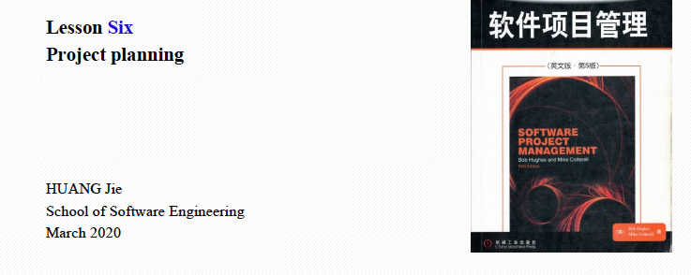

Slide 3
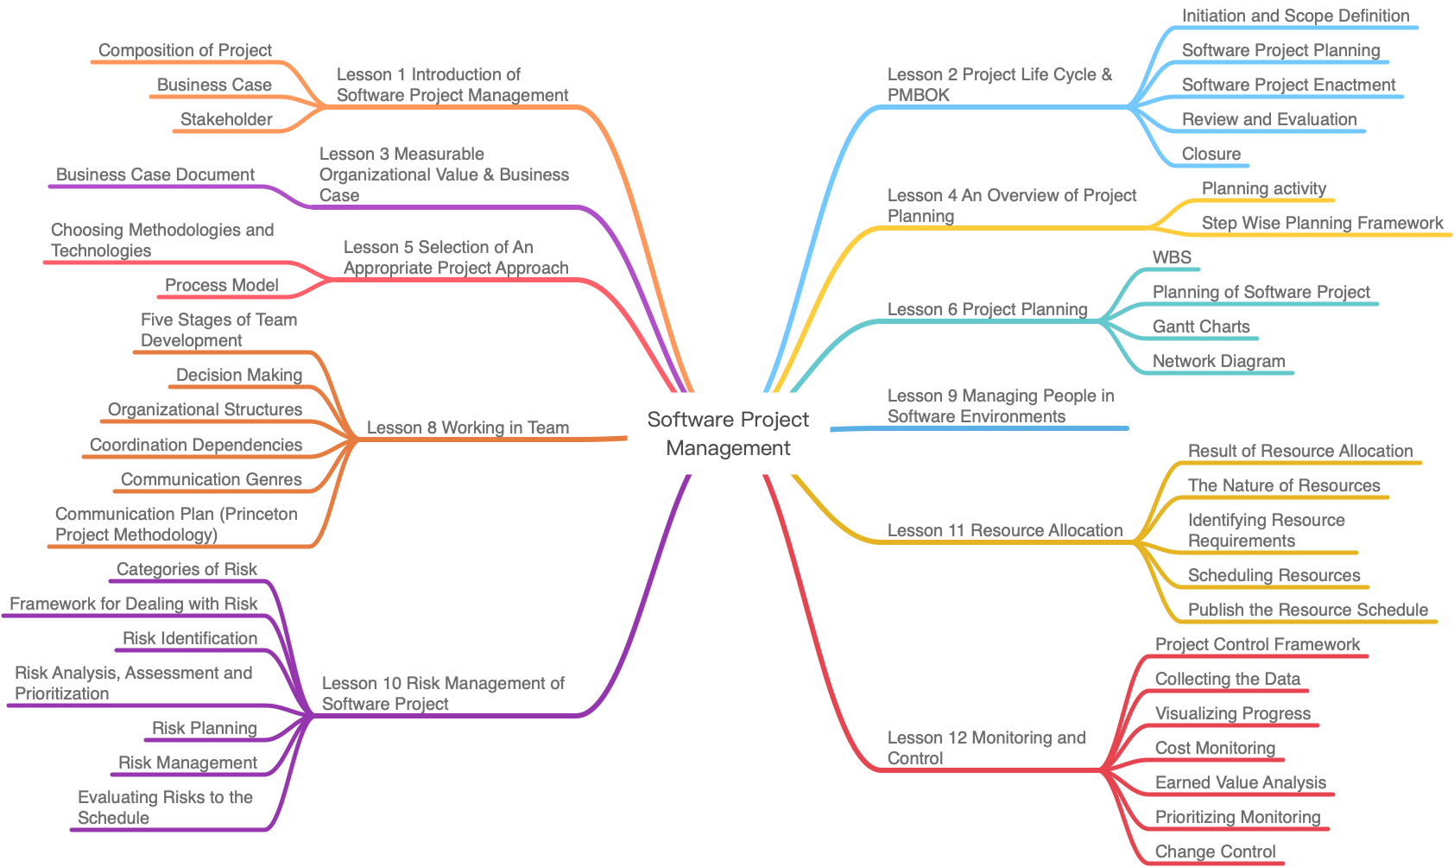

Slide 4
Initiation and Scope Definition
Background
Assumption
Vision
Feasibility
Requirements Analysis
Review and Evaluation
Planning Activity
Choosing Methodologies and Technologies
Step Wise Planning Framework
WBS
Process Model
Planning of Software Project
Five Stage of Team Development
Gantt Charts
Network Diagram
Organizational Structures
Prototype
Communication Style
Reference
Identifying Resource Requirements
Categories of Risk
Scheduling Resources
Framework for Dealing with Risk
Publish the Resource Schedule
Risk Identification
Project Control Framework
Risk Analysis, Assessment and Prioritization
Collecting the Data
Visualizing Progress
Risk Planning
Cost Monitoring
Risk Management
Earned Value Analysis
Evaluating Risks to the Schedule
Prioritizing Monitoring
Change Control

Slide 5
Background
Categories of Risk
Vision
Framework for Dealing with Risk
Requirements Analysis
Risk Analysis, Assessment and Prioritization
Assumption
Initiation and Scope Definition
Risk Planning
Review and Evaluation
Risk Management
Feasibility
Risk Identification
Planning Activity
Evaluating Risks to the Schedule
Step Wise Planning Framework
Network Diagram
Identifying Resource Requirements
Gantt Charts
Communication Style
Scheduling Resources
WBS
Organizational Structures
Publish the Resource Schedule
Planning of Software Project
Project Control Framework
Choosing Methodologies and Technologies
Collecting the Data
Cost Monitoring
Process Model
Visualizing Progress
Prototype
Earned Value Analysis
Prioritizing Monitoring
Reference
Change Control

Slide 6
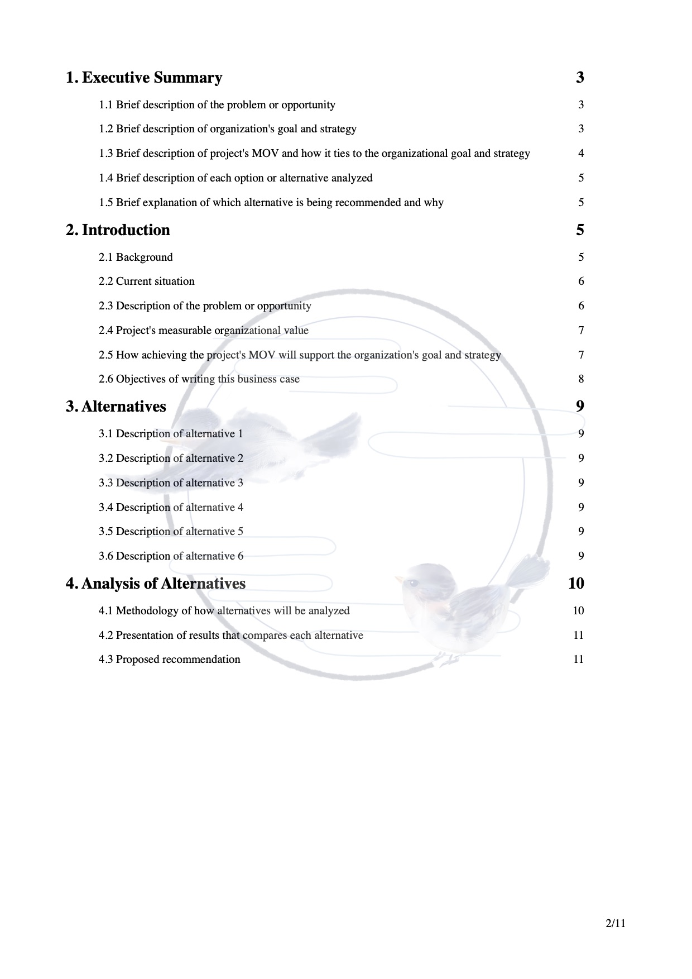
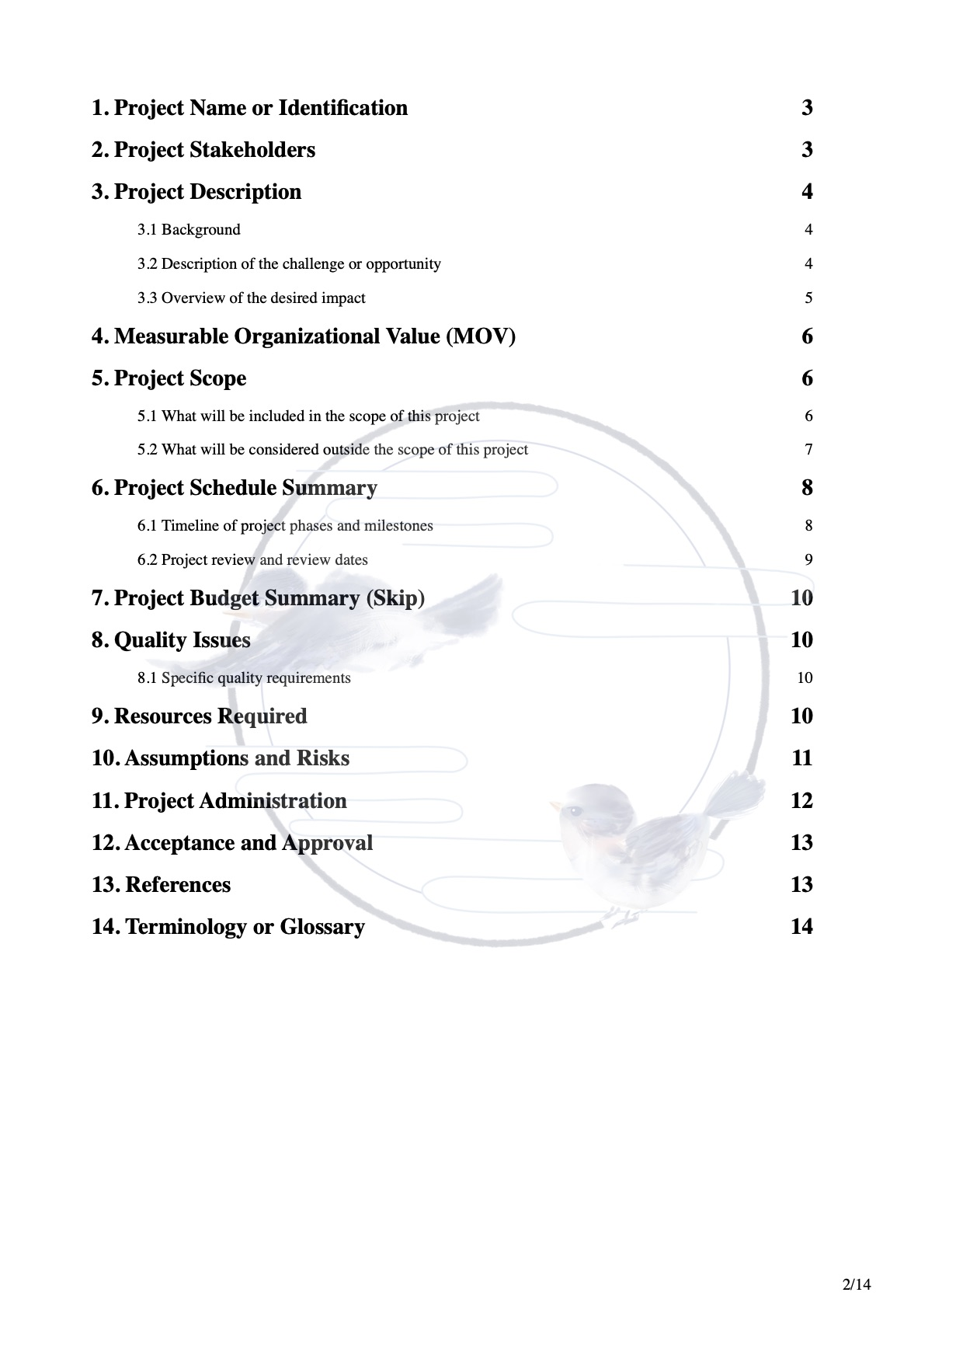
1. General View
4. Risk Management
6. Monitor & Control
Background
Categories of Risk
Collecting the Data
Vision
Framework for Dealing with Risk
Visualizing Progress
Requirements Analysis
Risk Analysis, Assessment and Prioritization
Cost Monitoring
Assumption
Earned Value Analysis
2. Initiation and Scope Definition
Risk Planning
Change Control
Risk Management
7. Project Implementation
Risk Identification
Requirement Management
Evaluating Risks to the Schedule
Review and Evaluation
Choosing Methodologies and Technologies
5. Resource Allocation
Feasibility
Process Model
Scope
Identifying Resource Requirements
3. Planning Management
8. Prototype
Scheduling Resources
Planning Activity
Project Control Framework
9. Reference
Project Organization
Communication Style
Organizational Structures
Planning of Software Project
WBS
Gantt Charts
Network Diagram

Slide 7
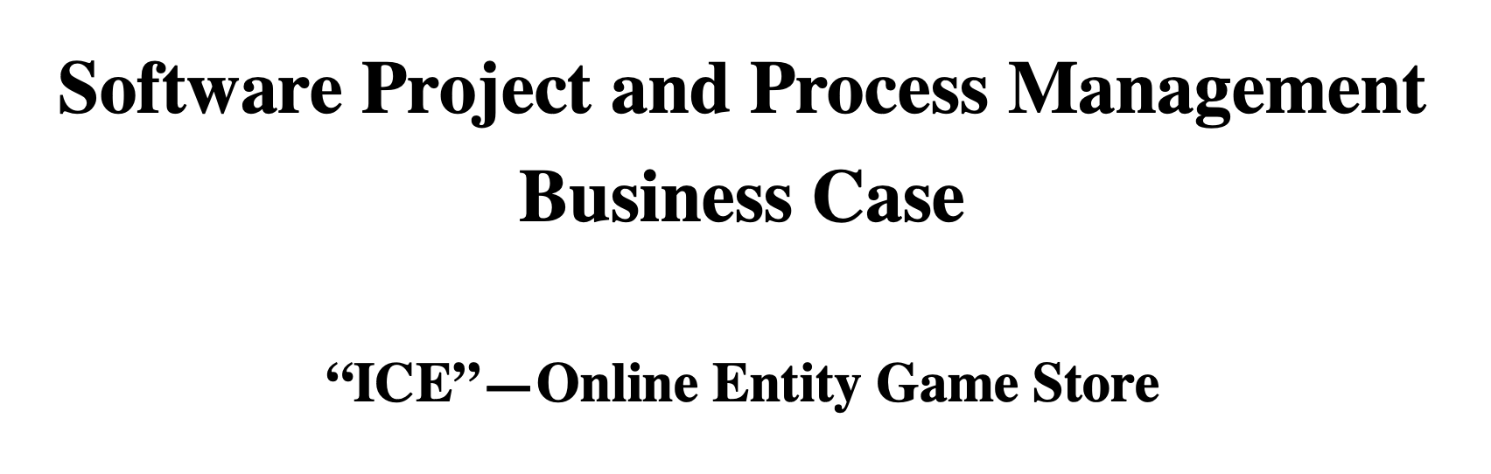
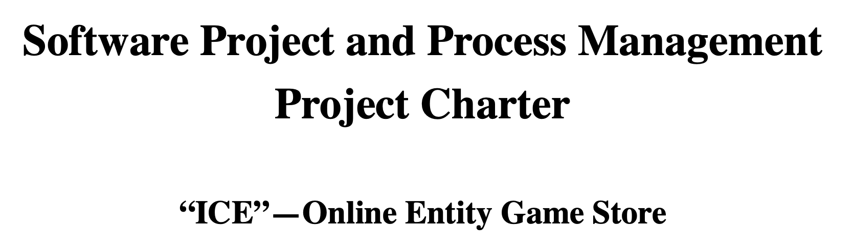

Slide 8

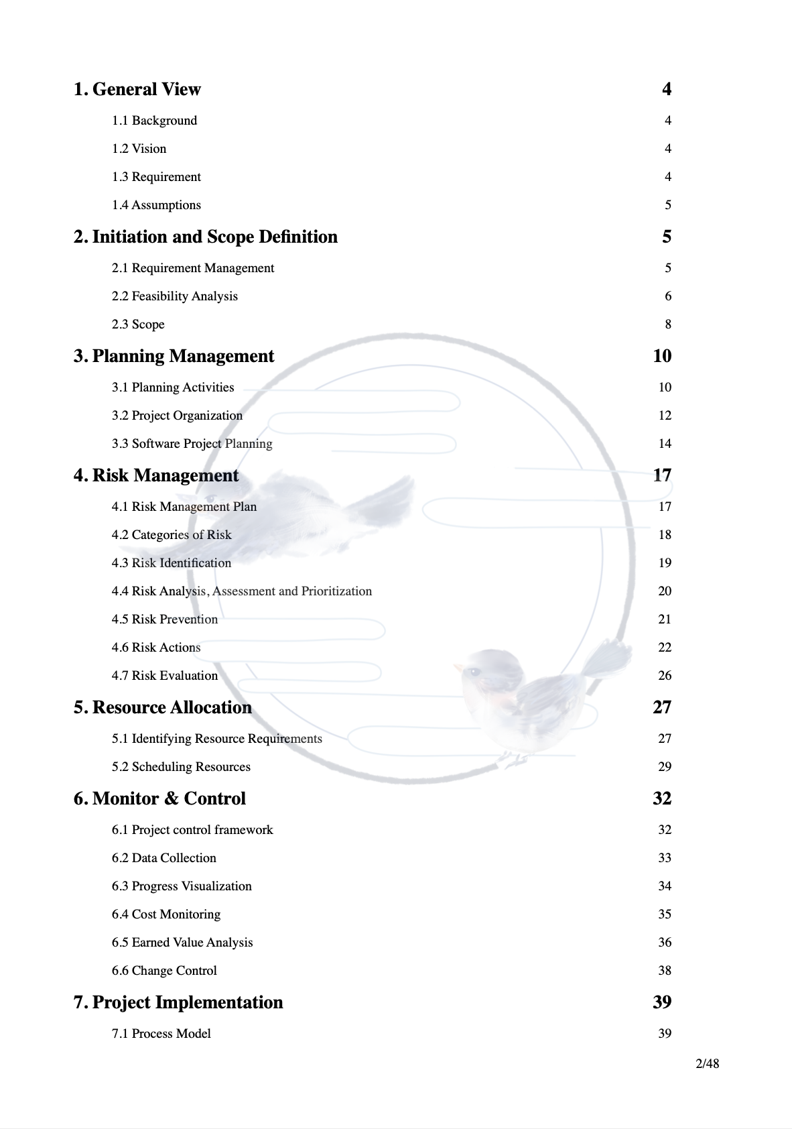

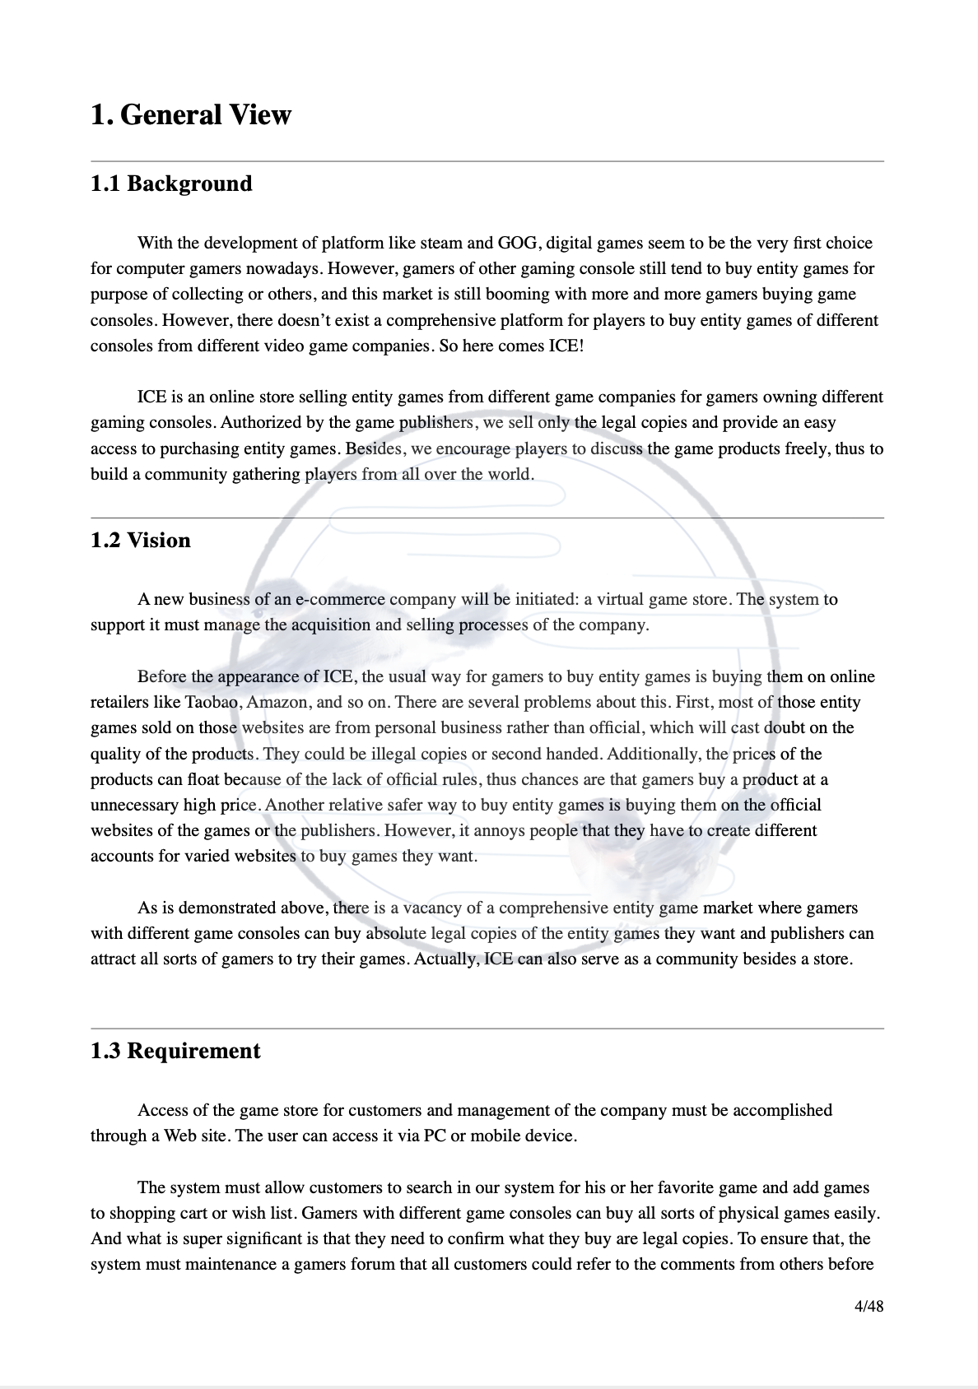
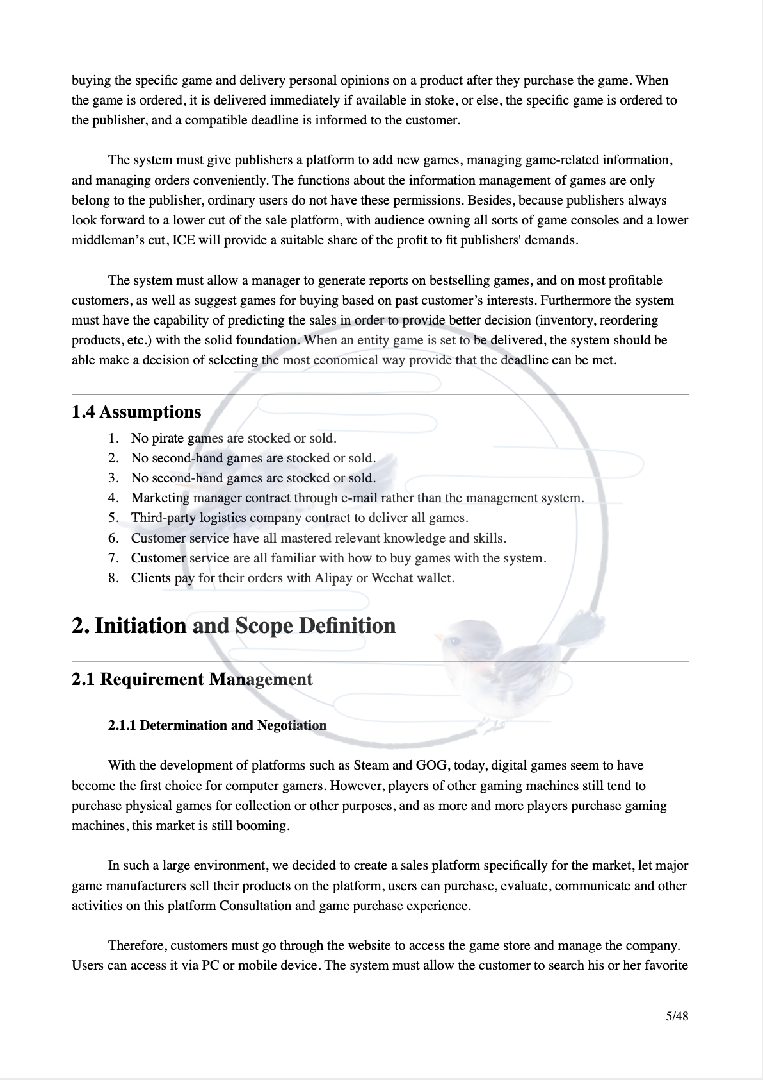
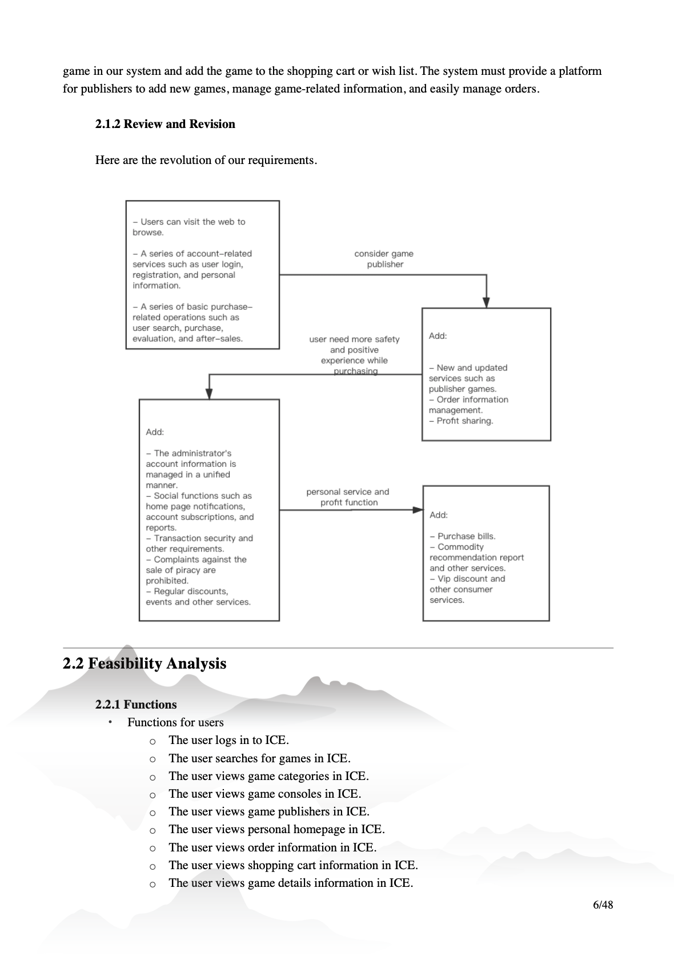
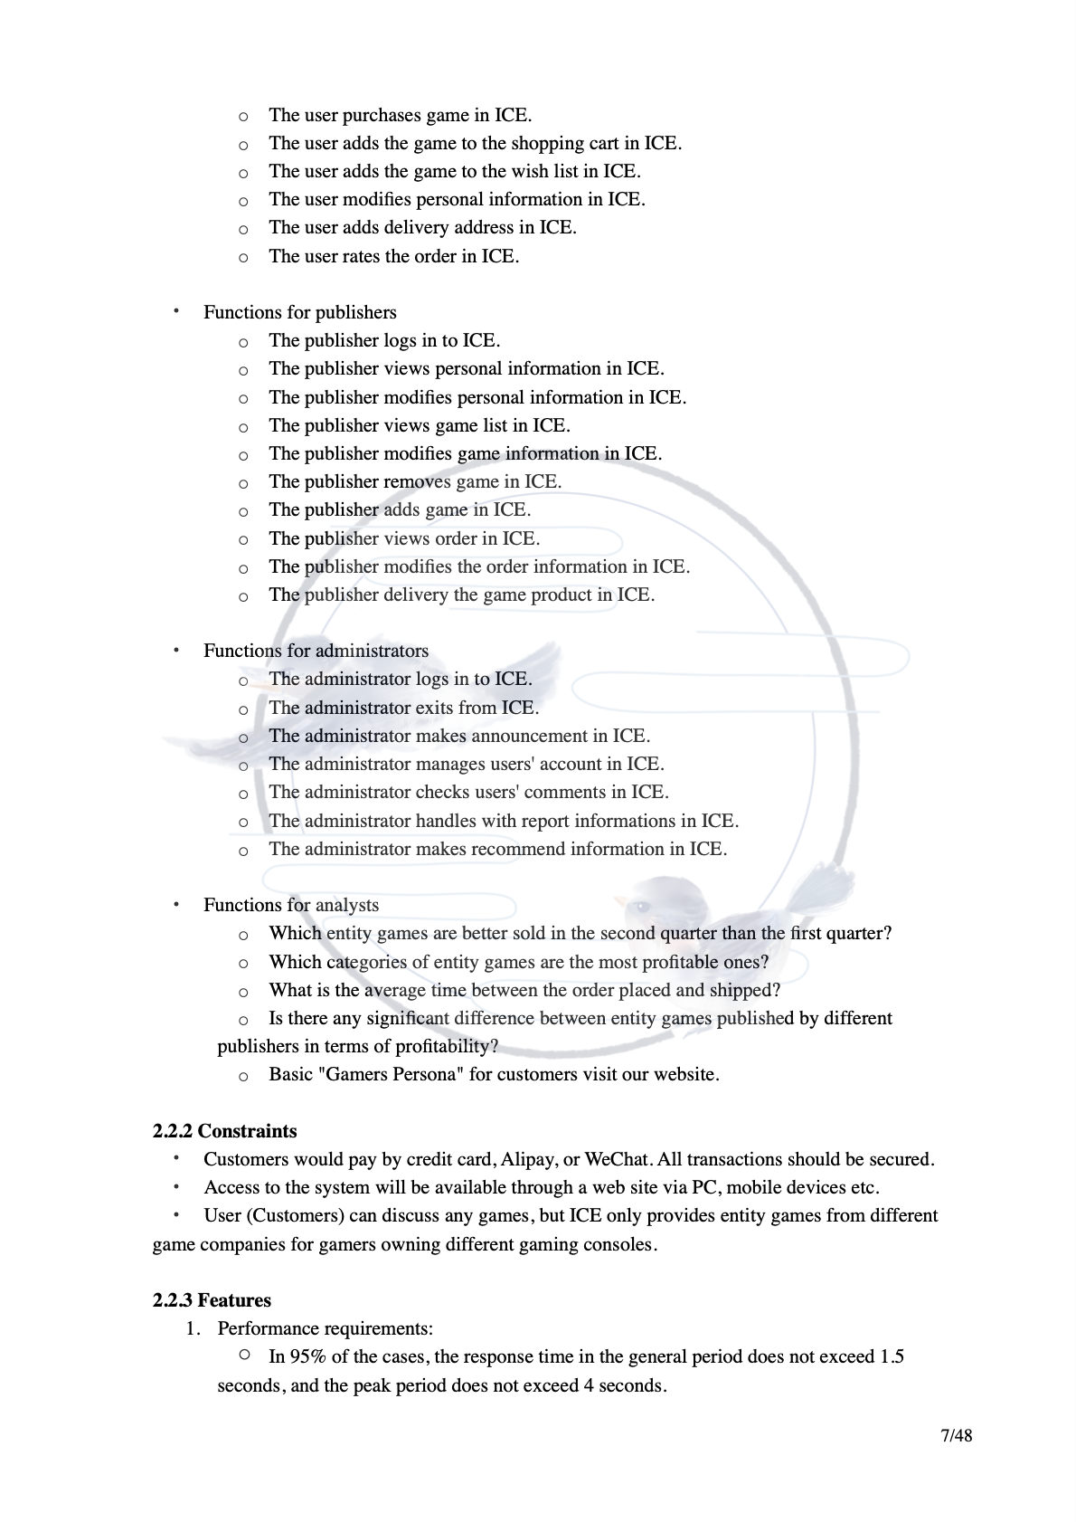
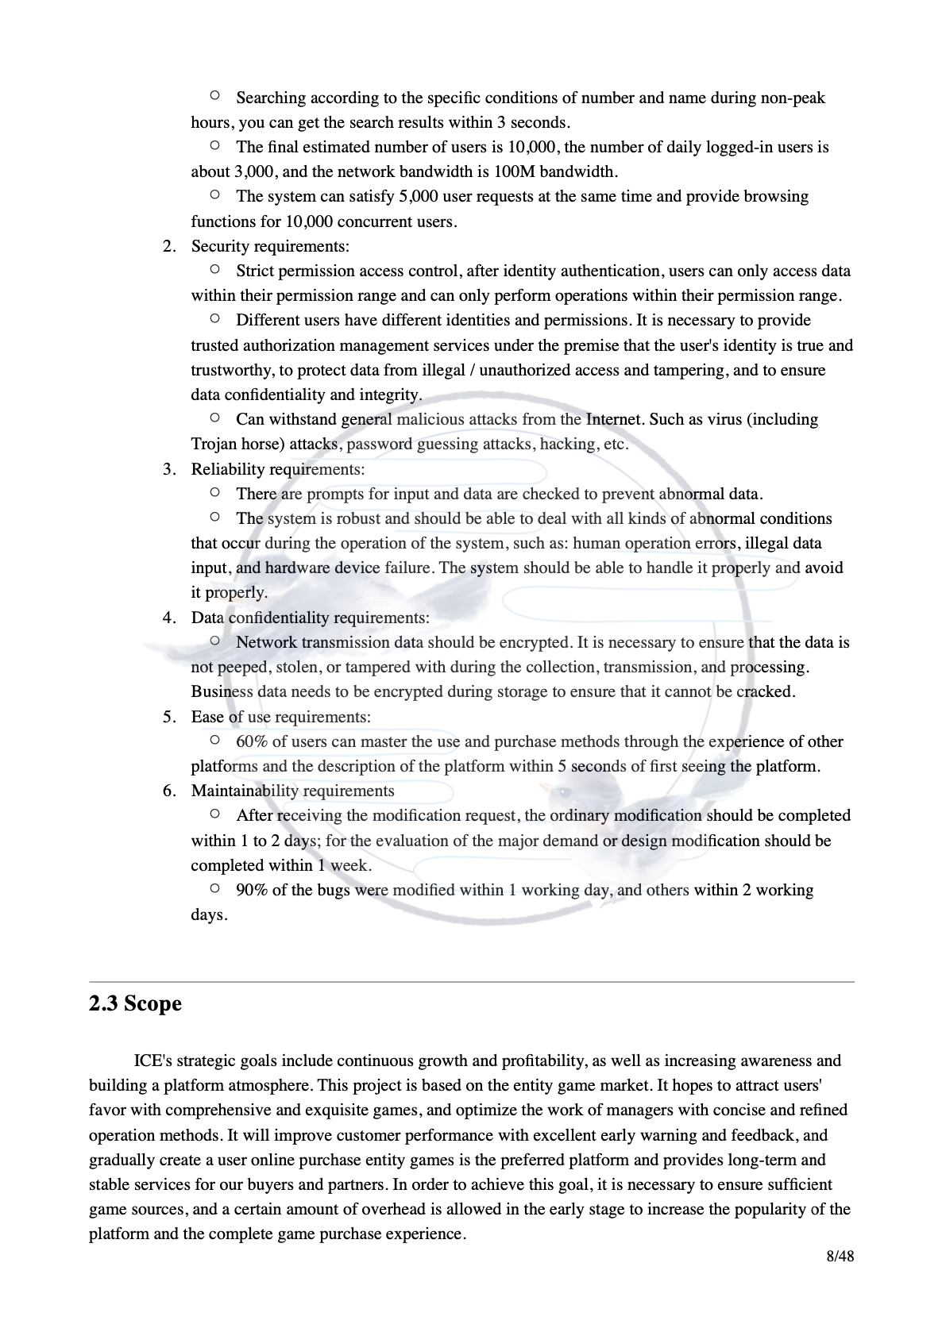

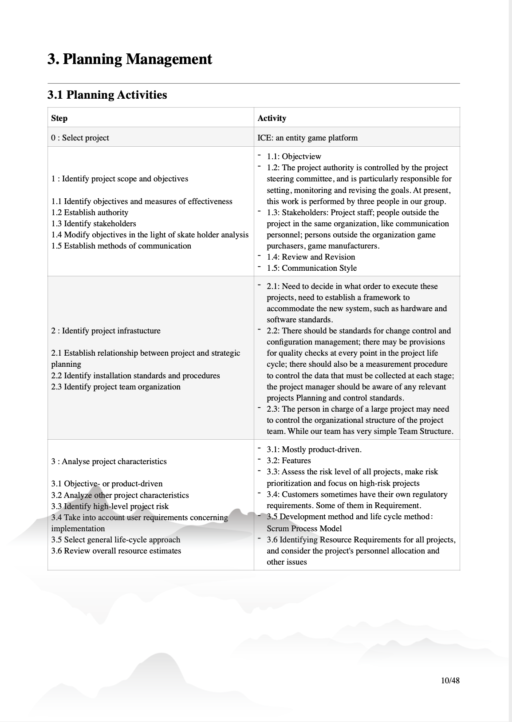
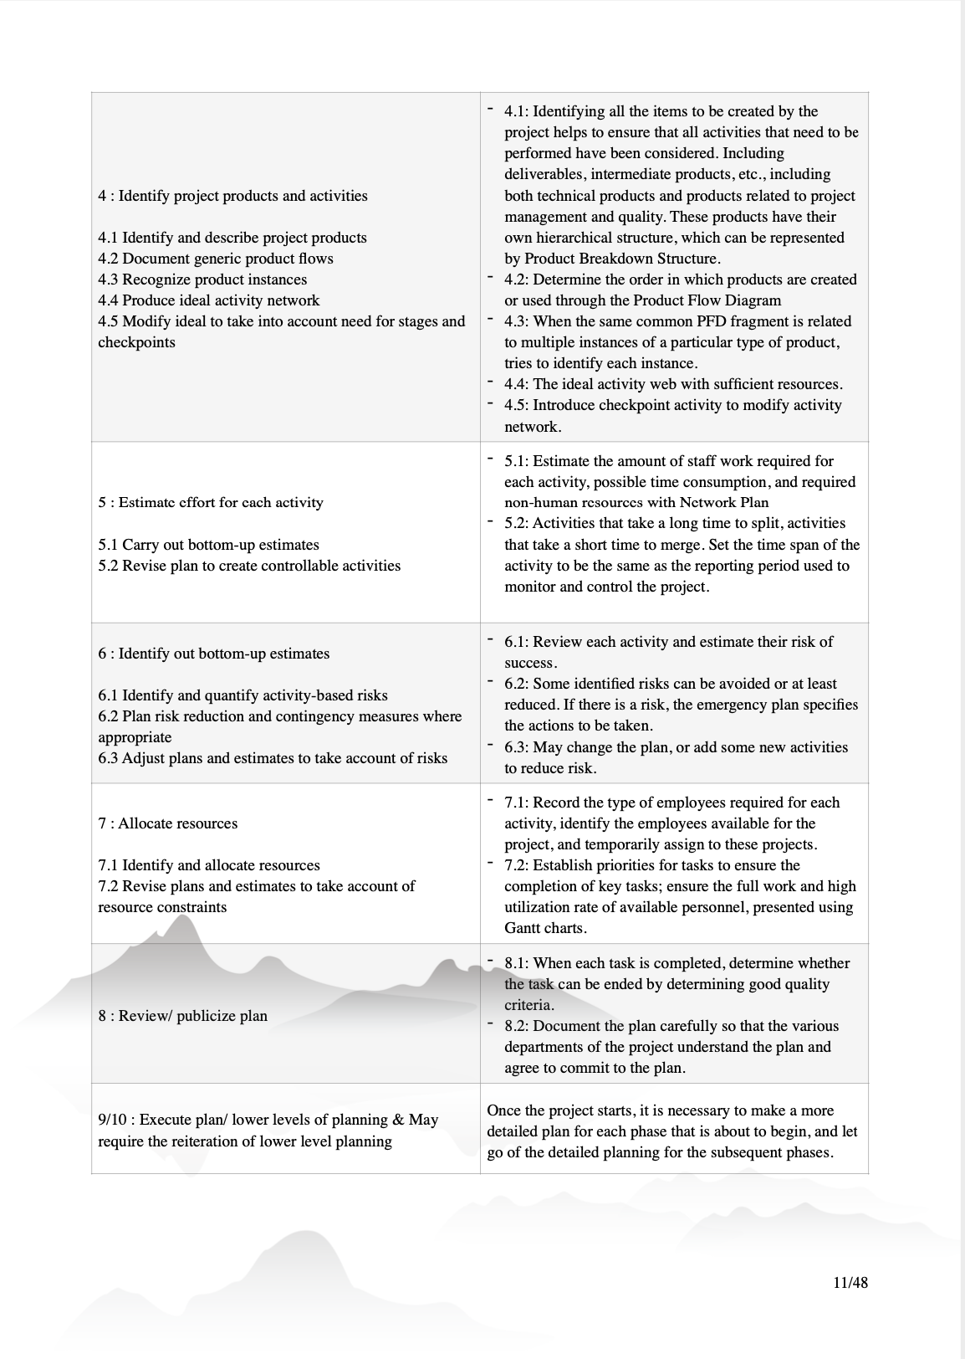
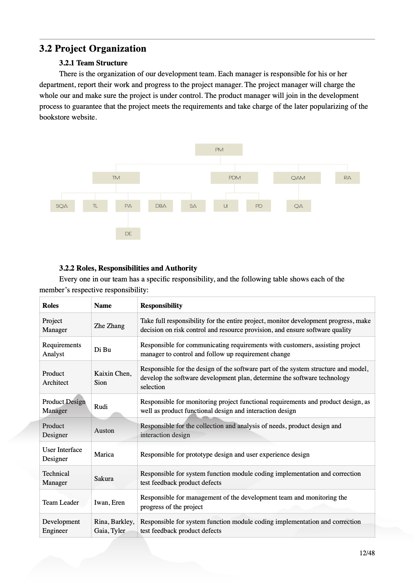
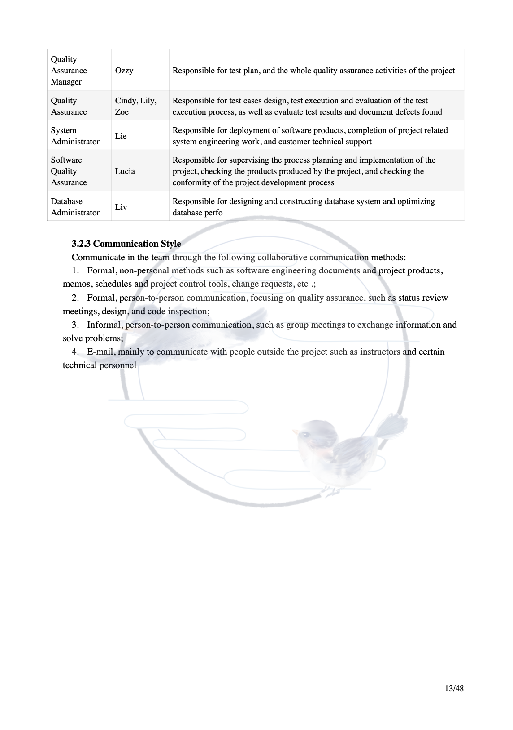
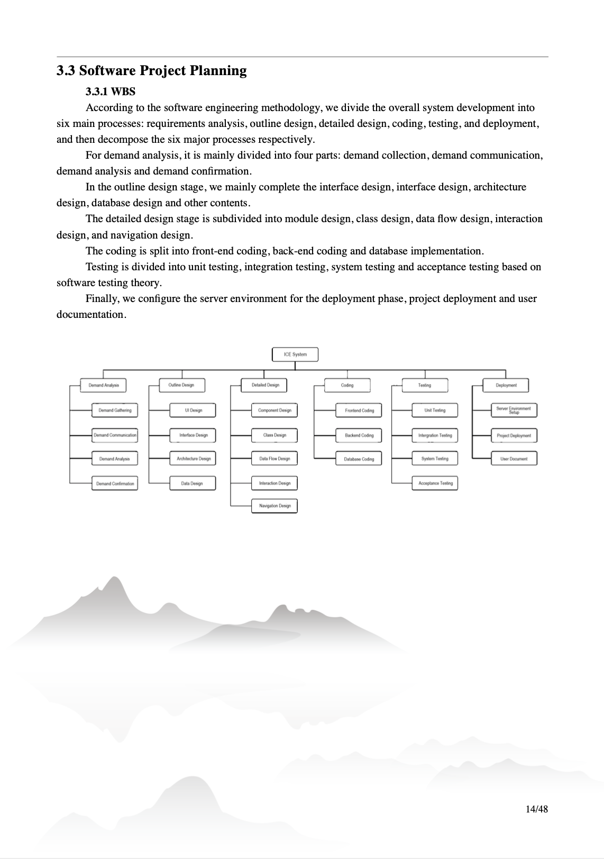
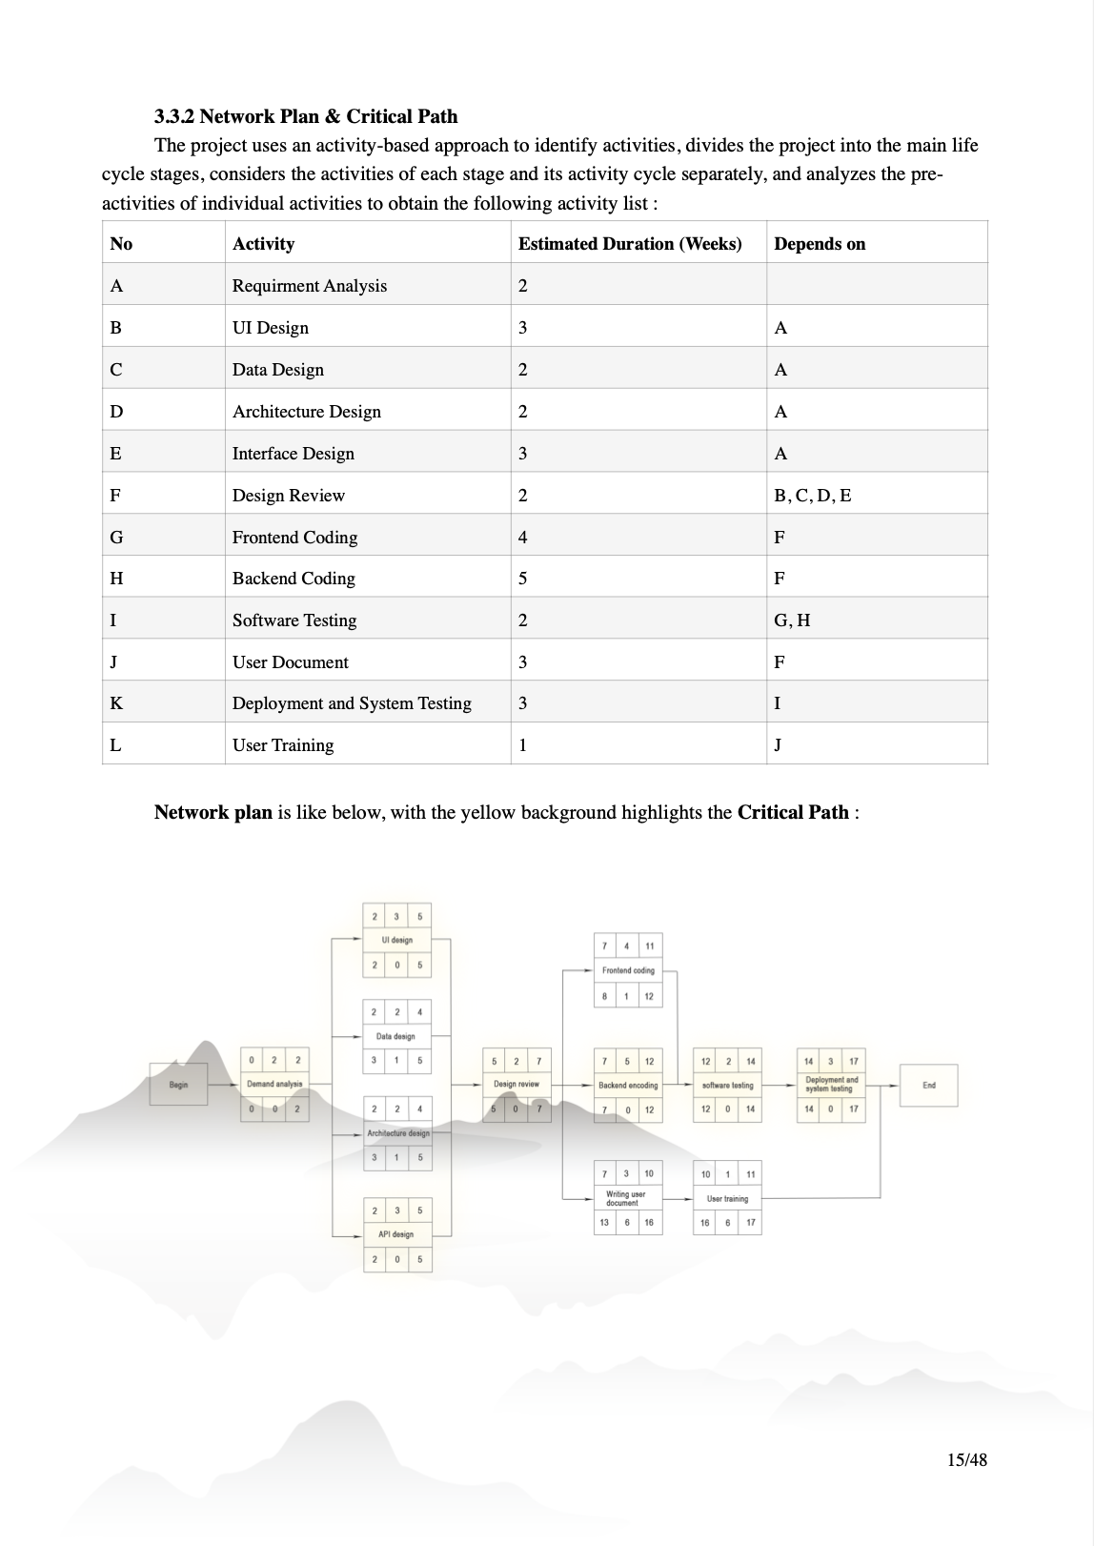
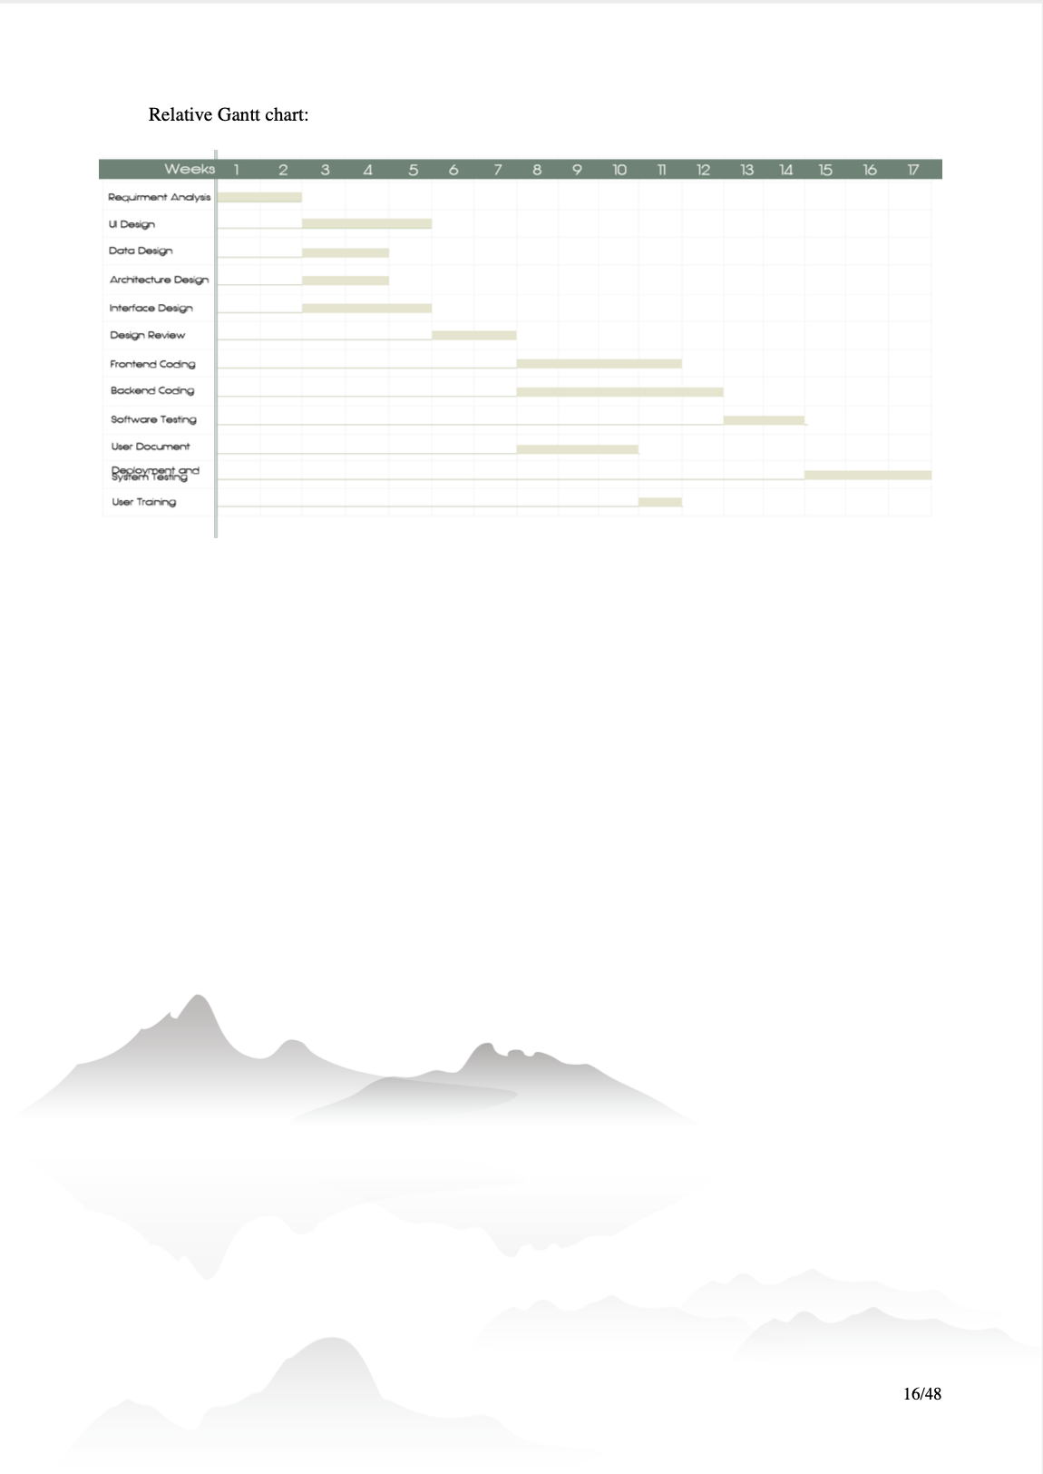
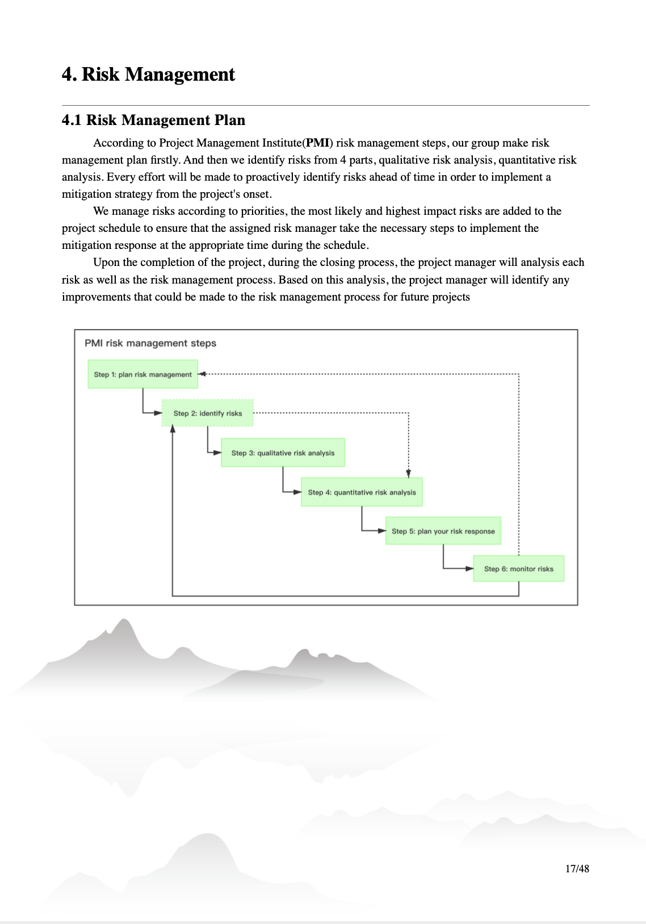
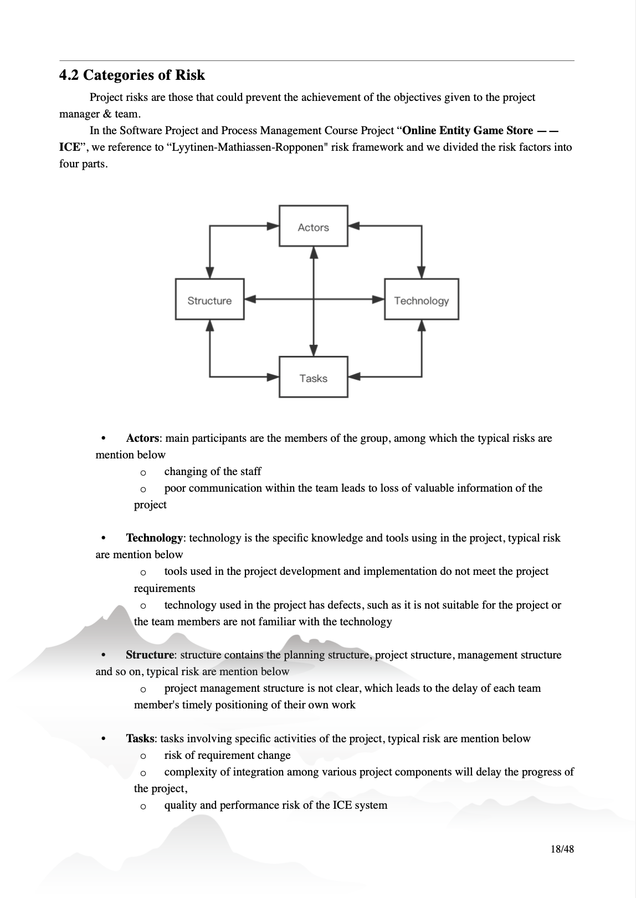
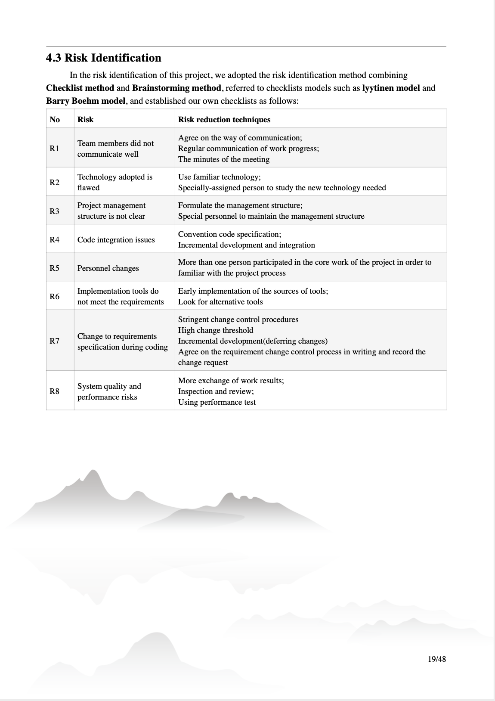
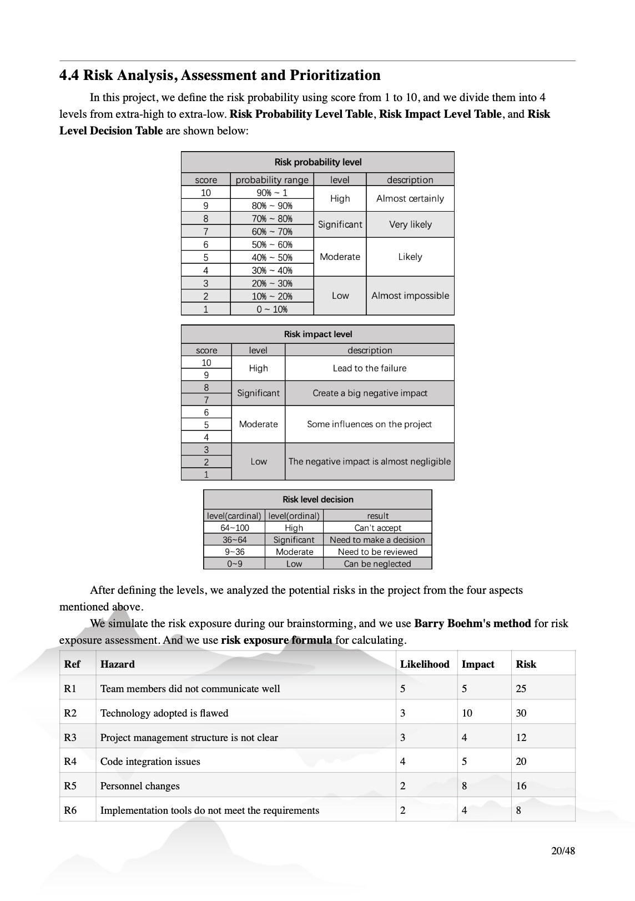
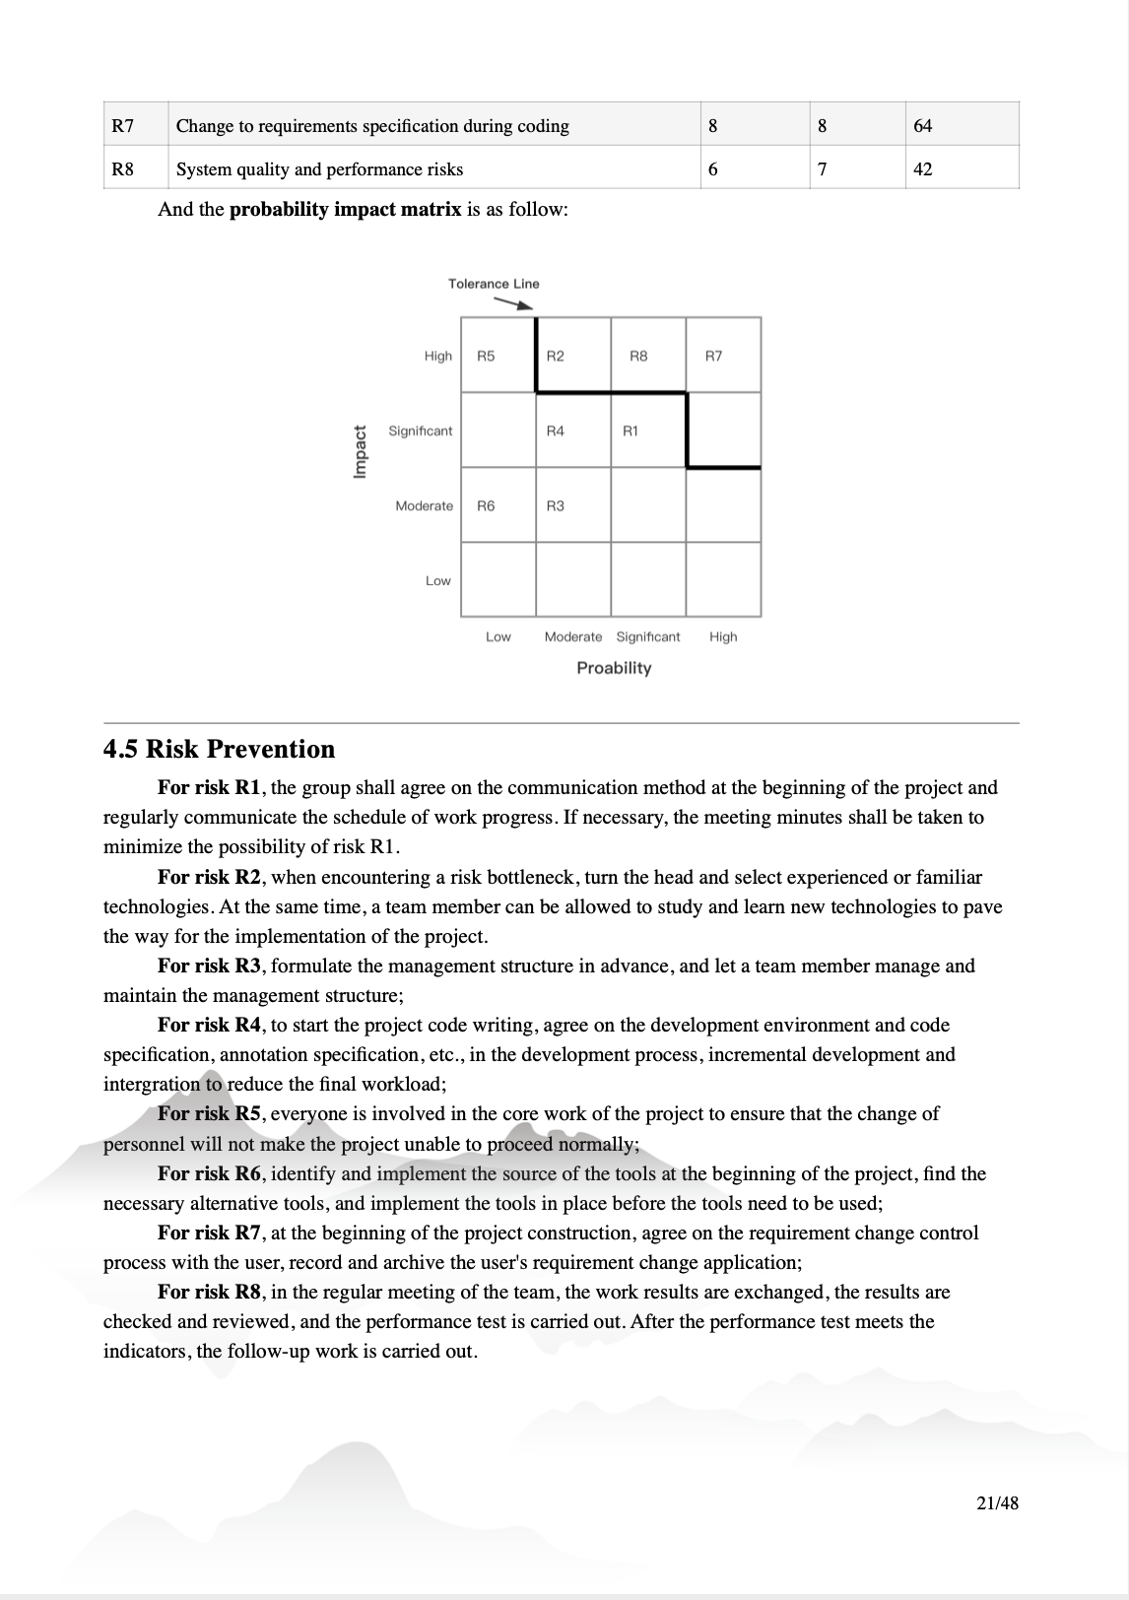
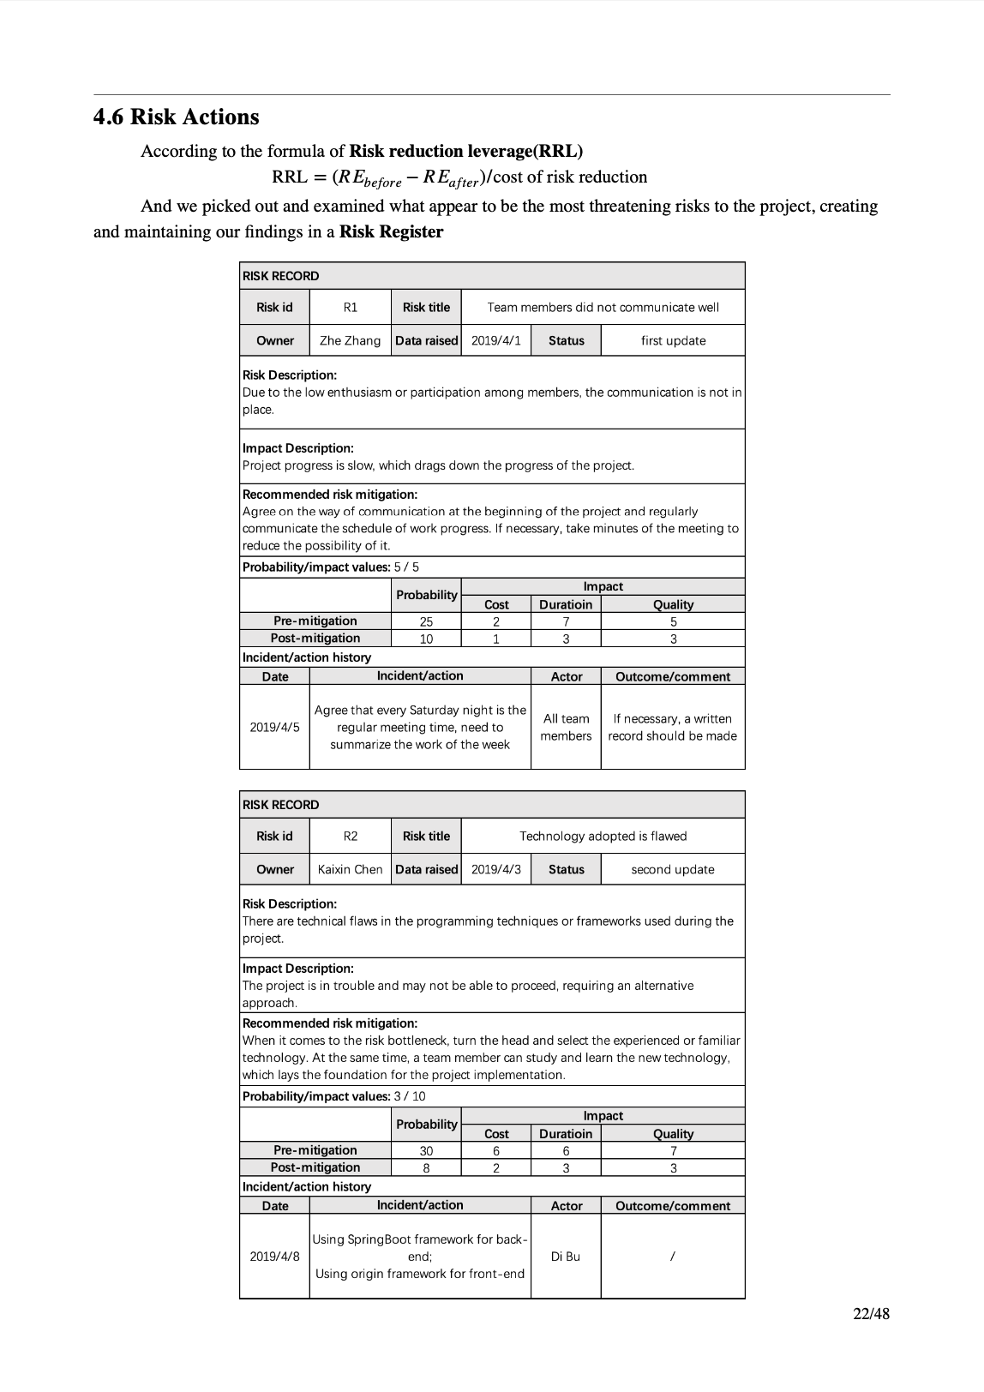
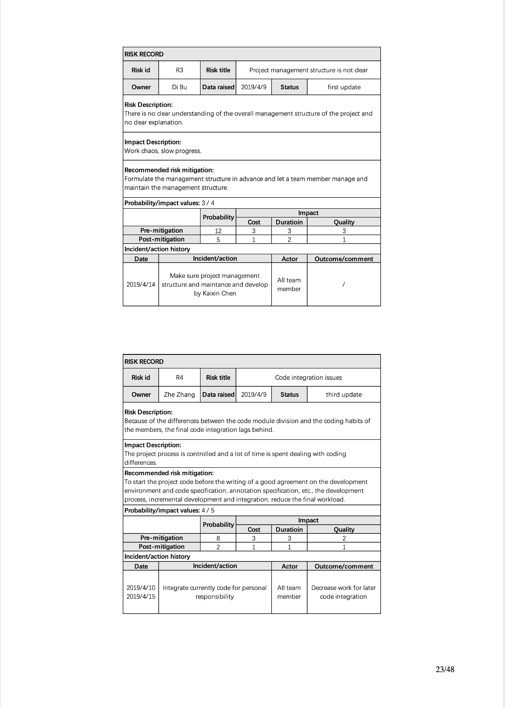
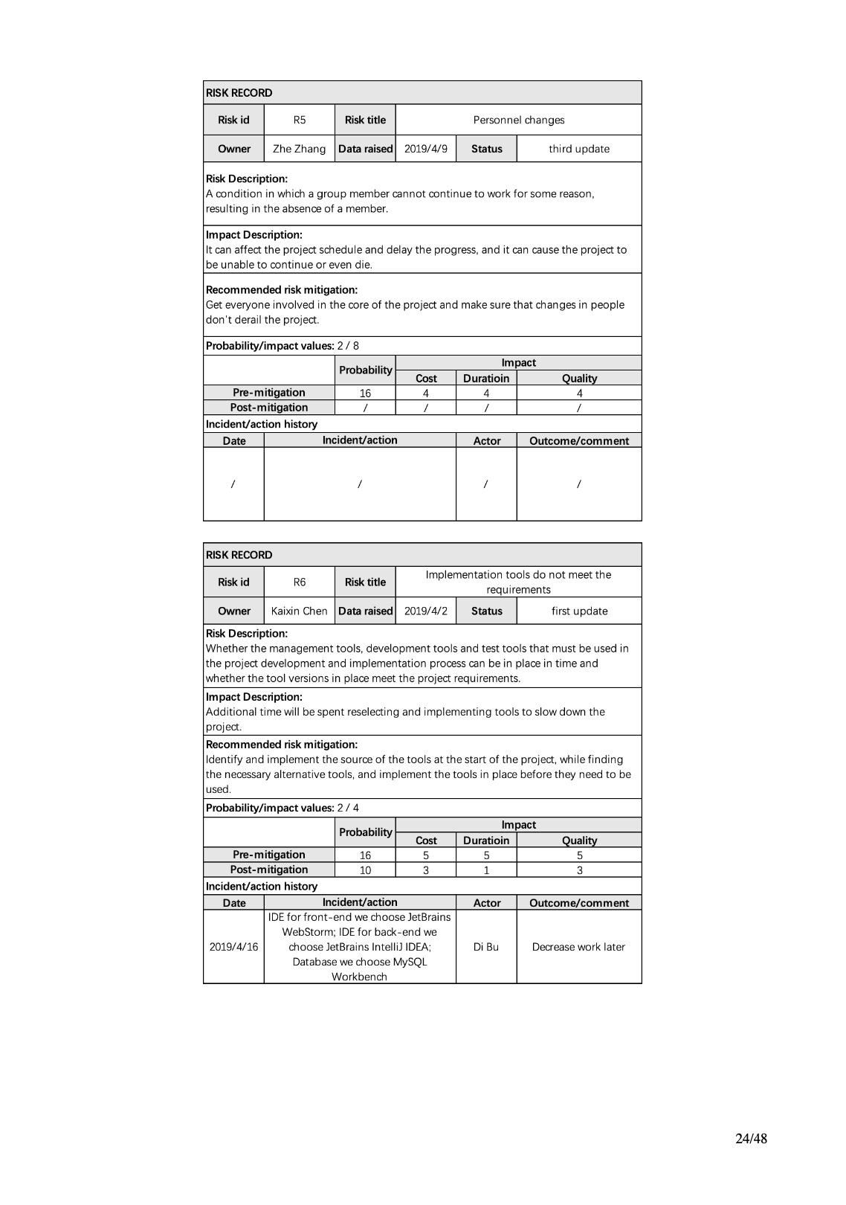
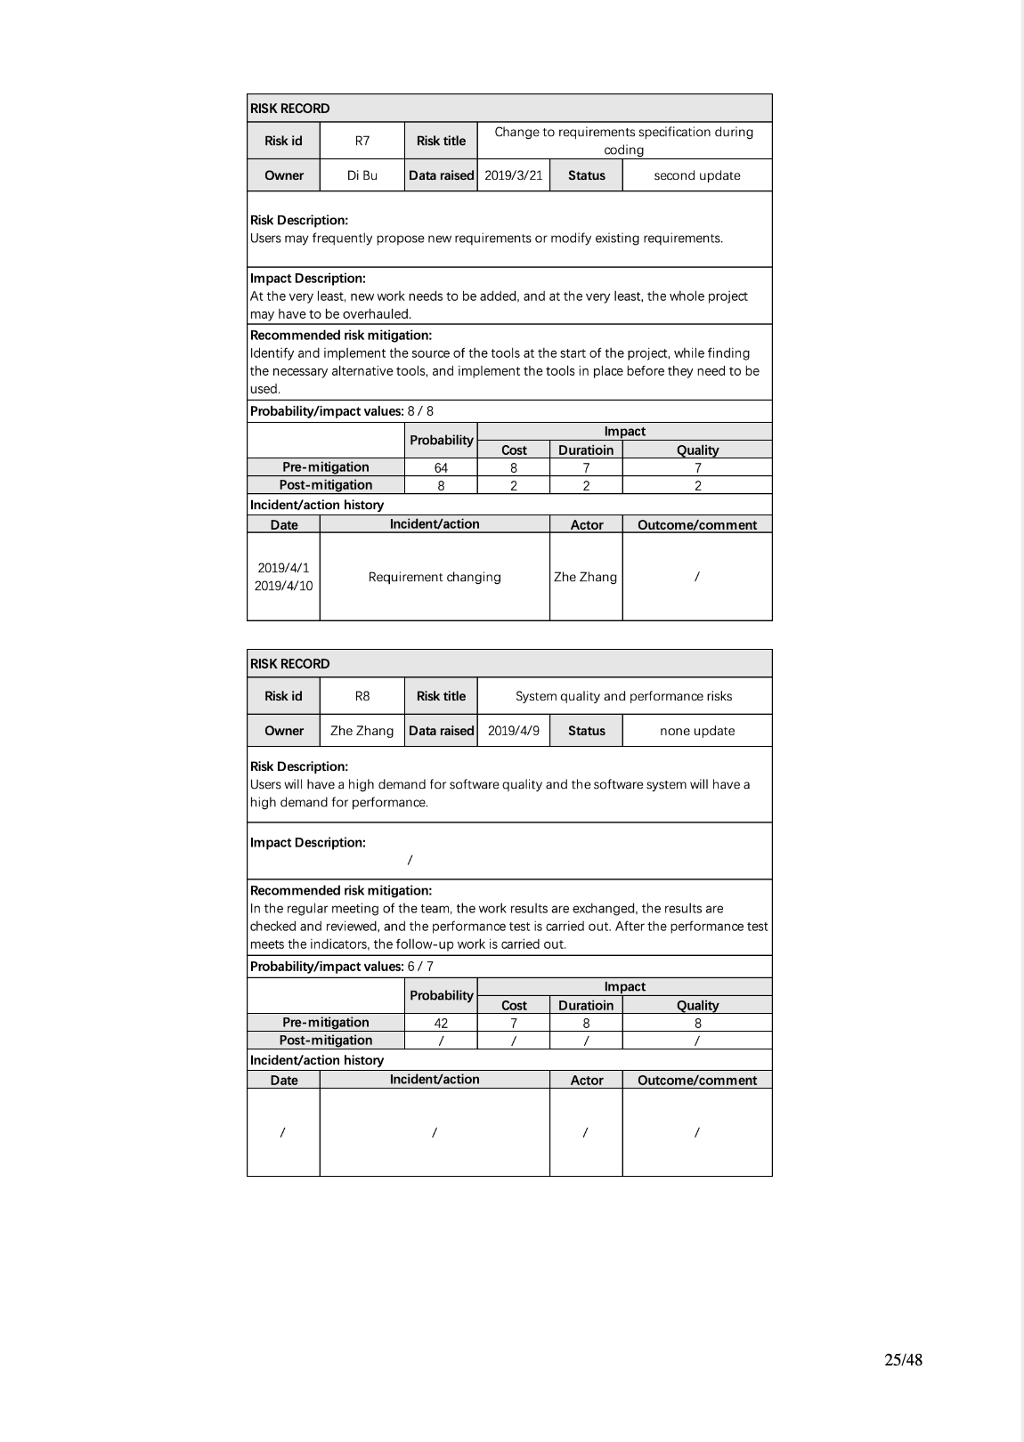
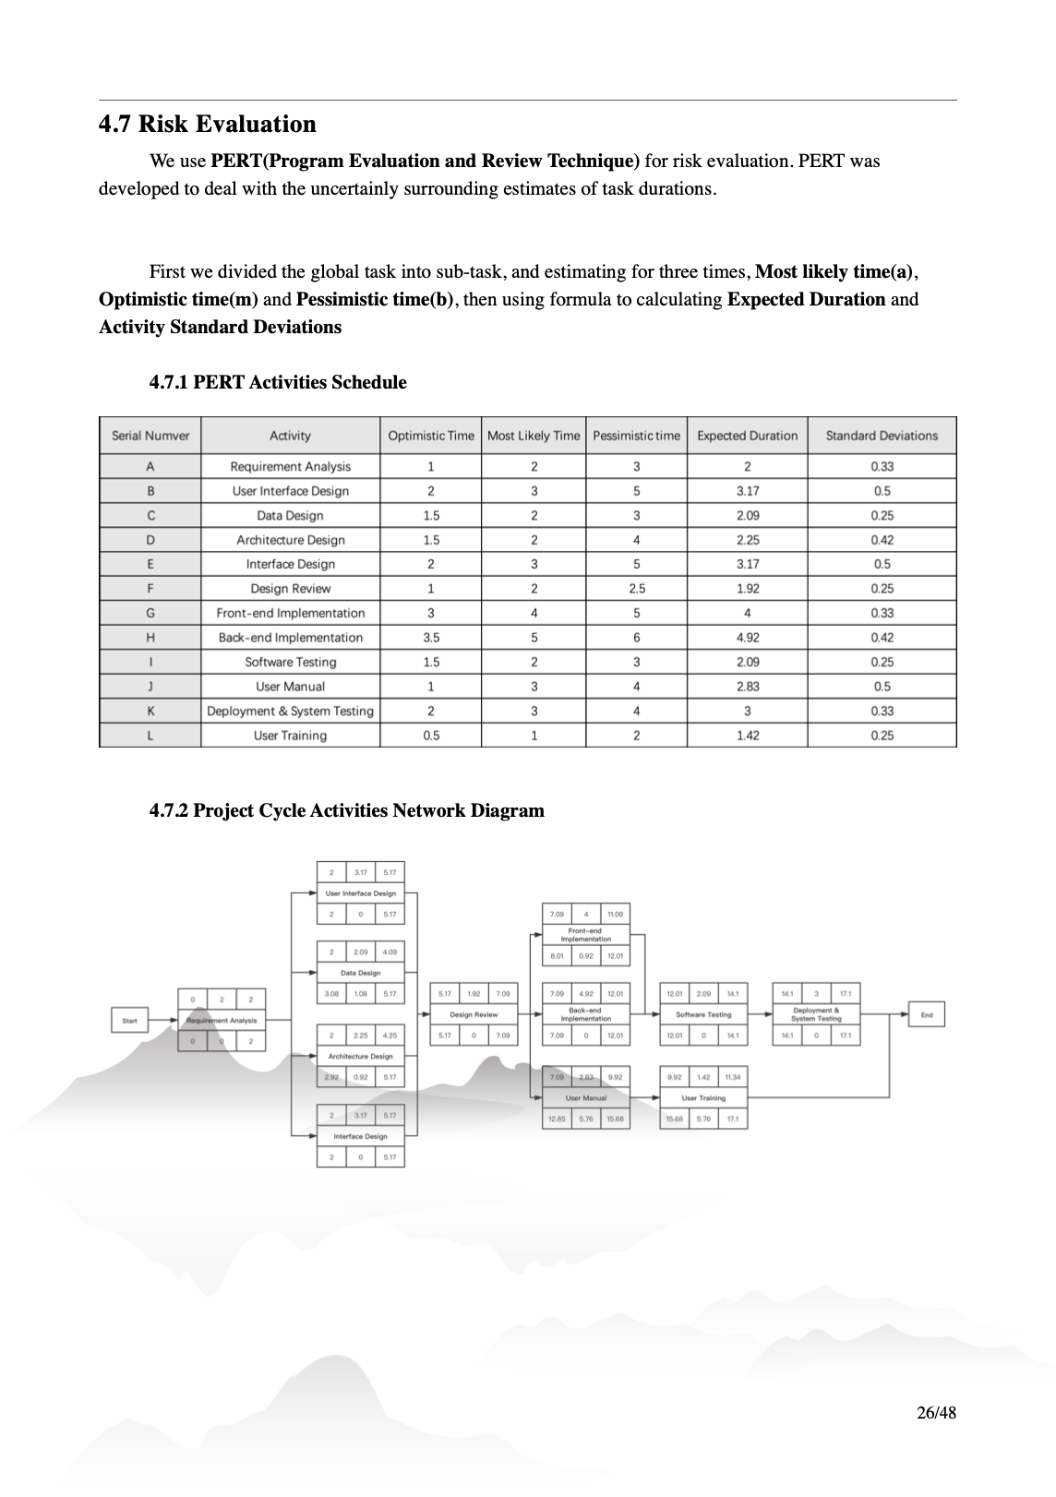
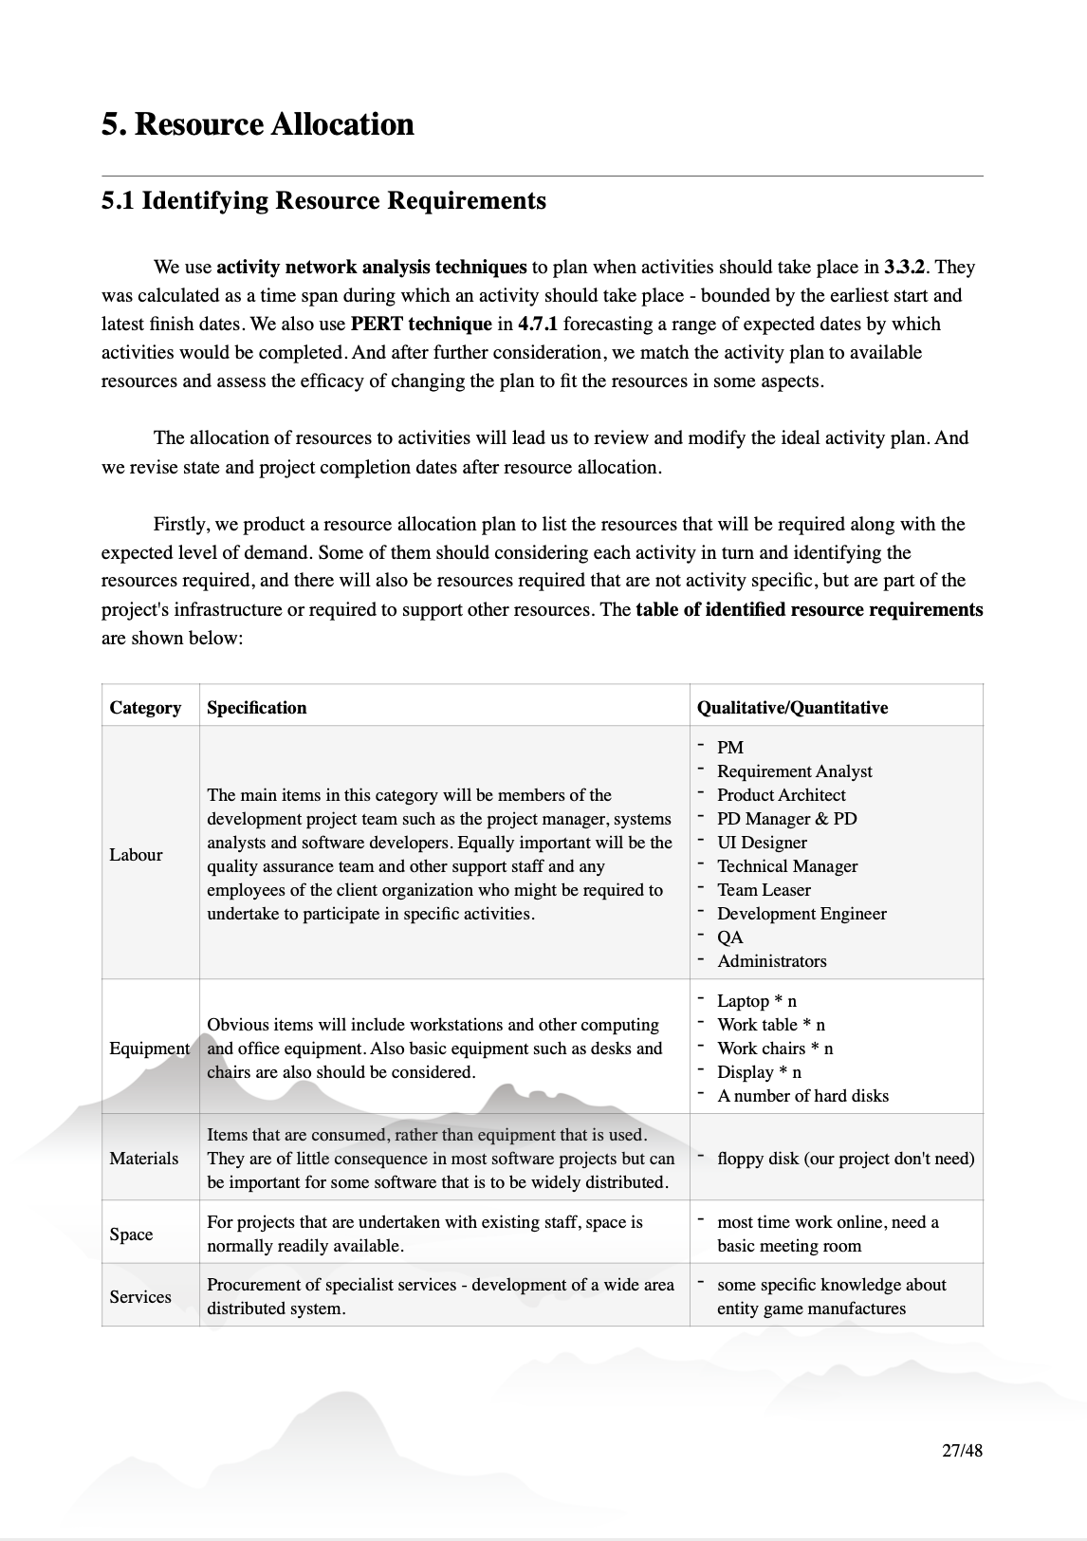
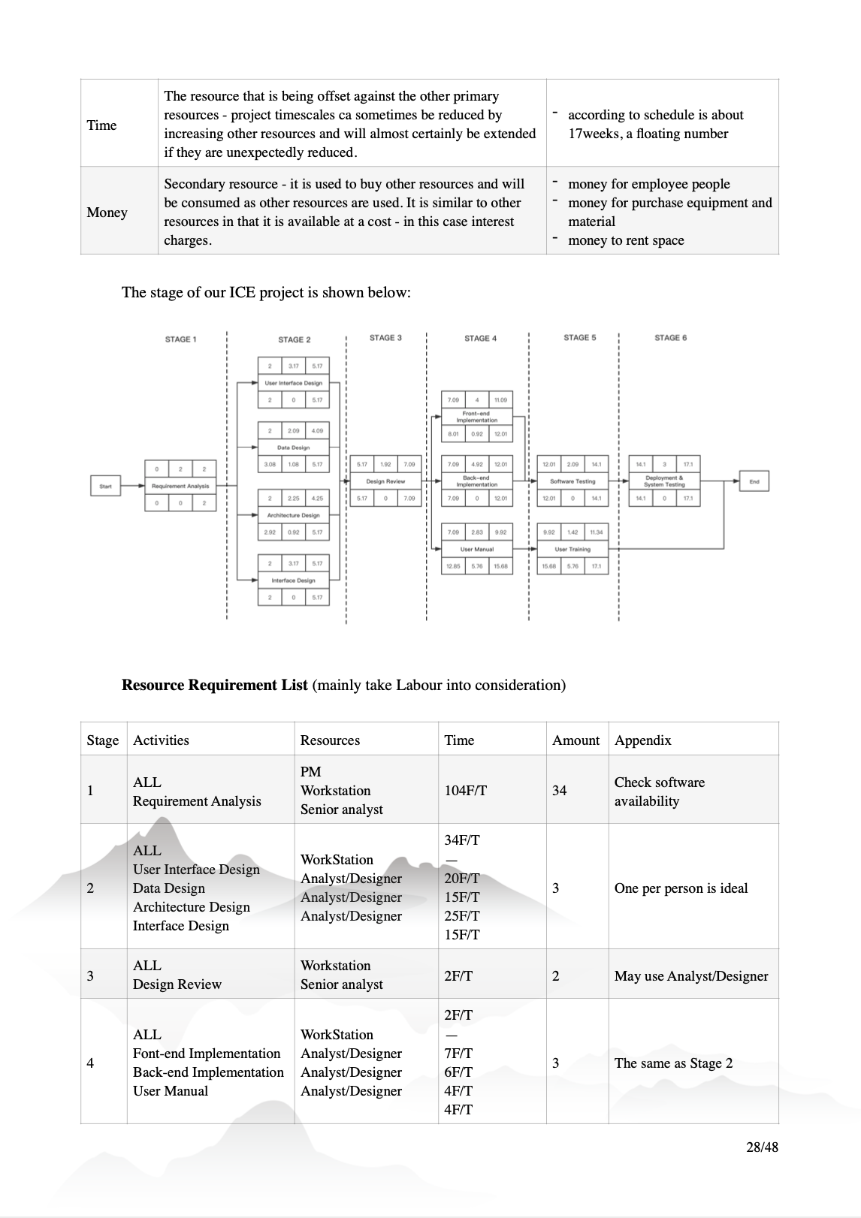
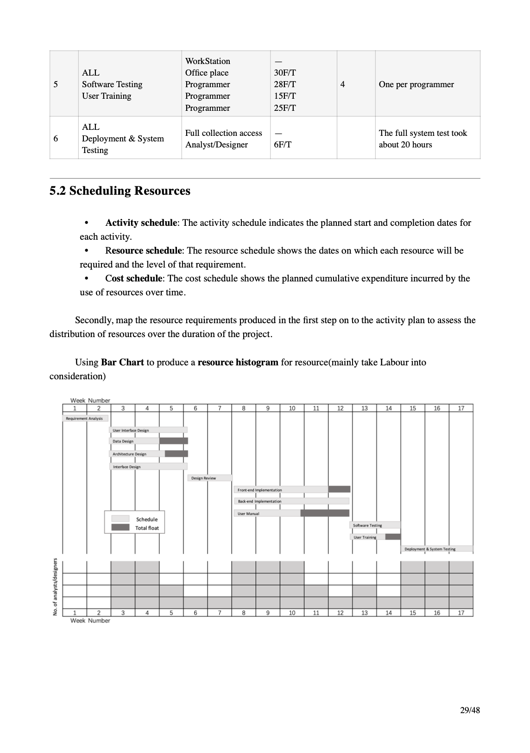
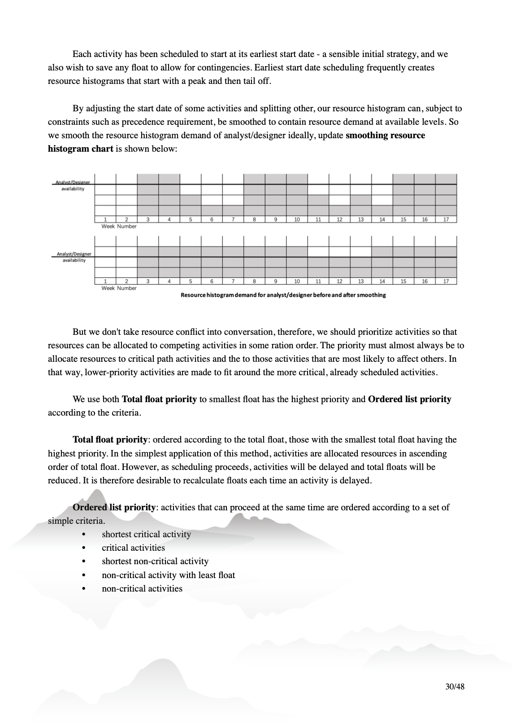
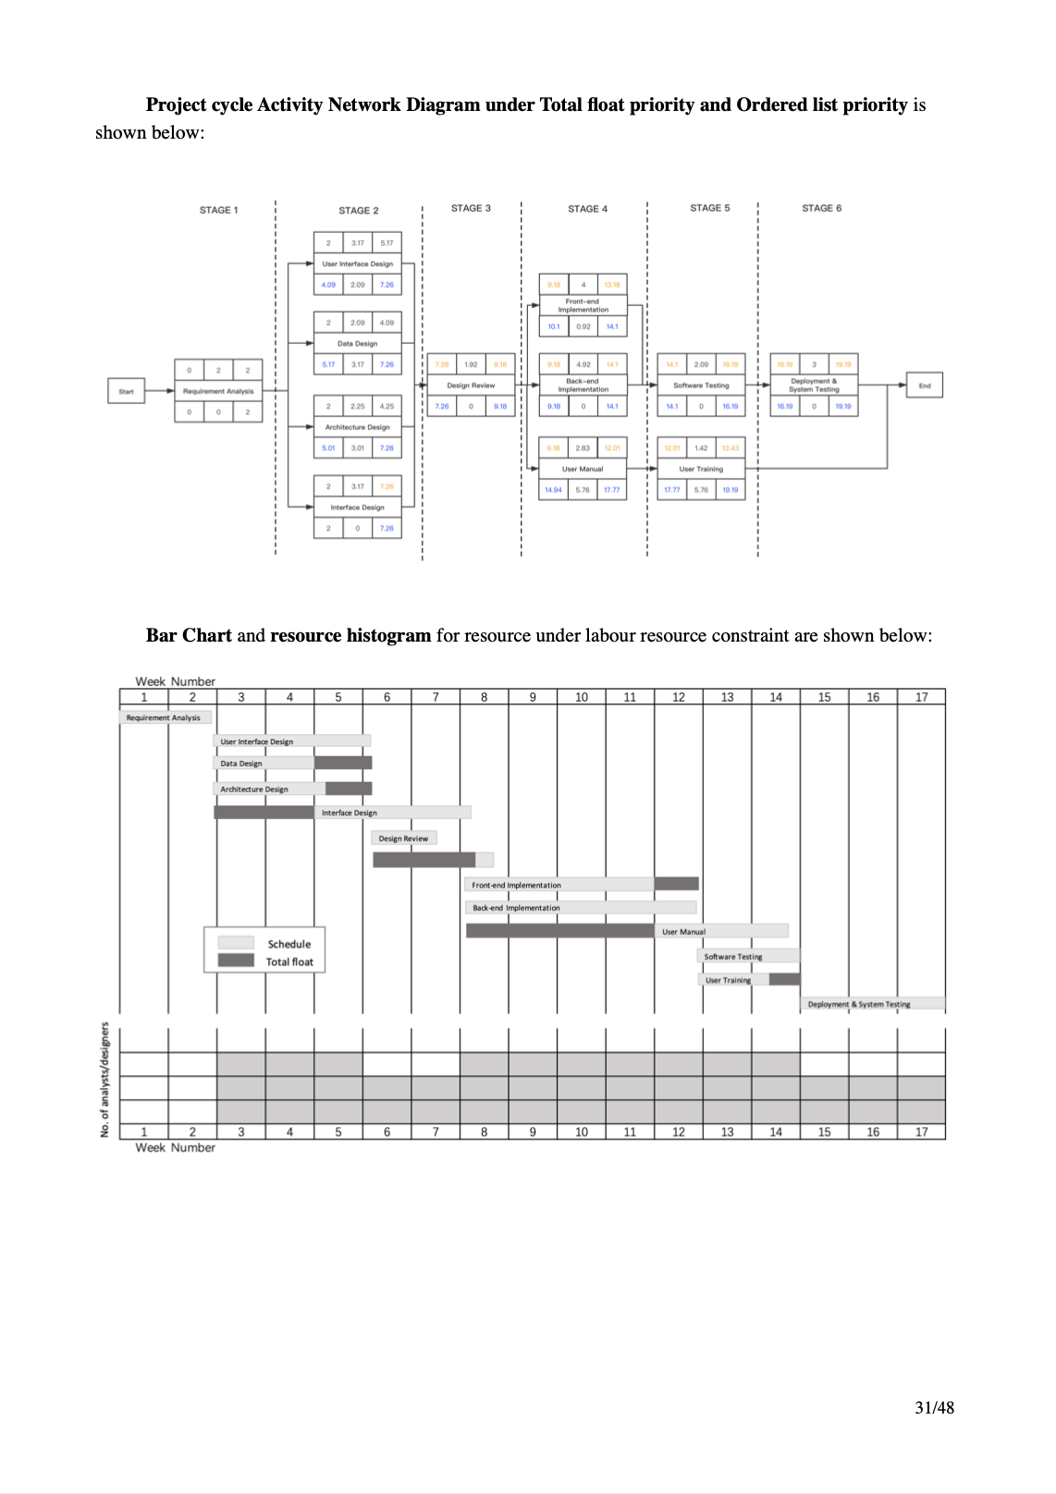
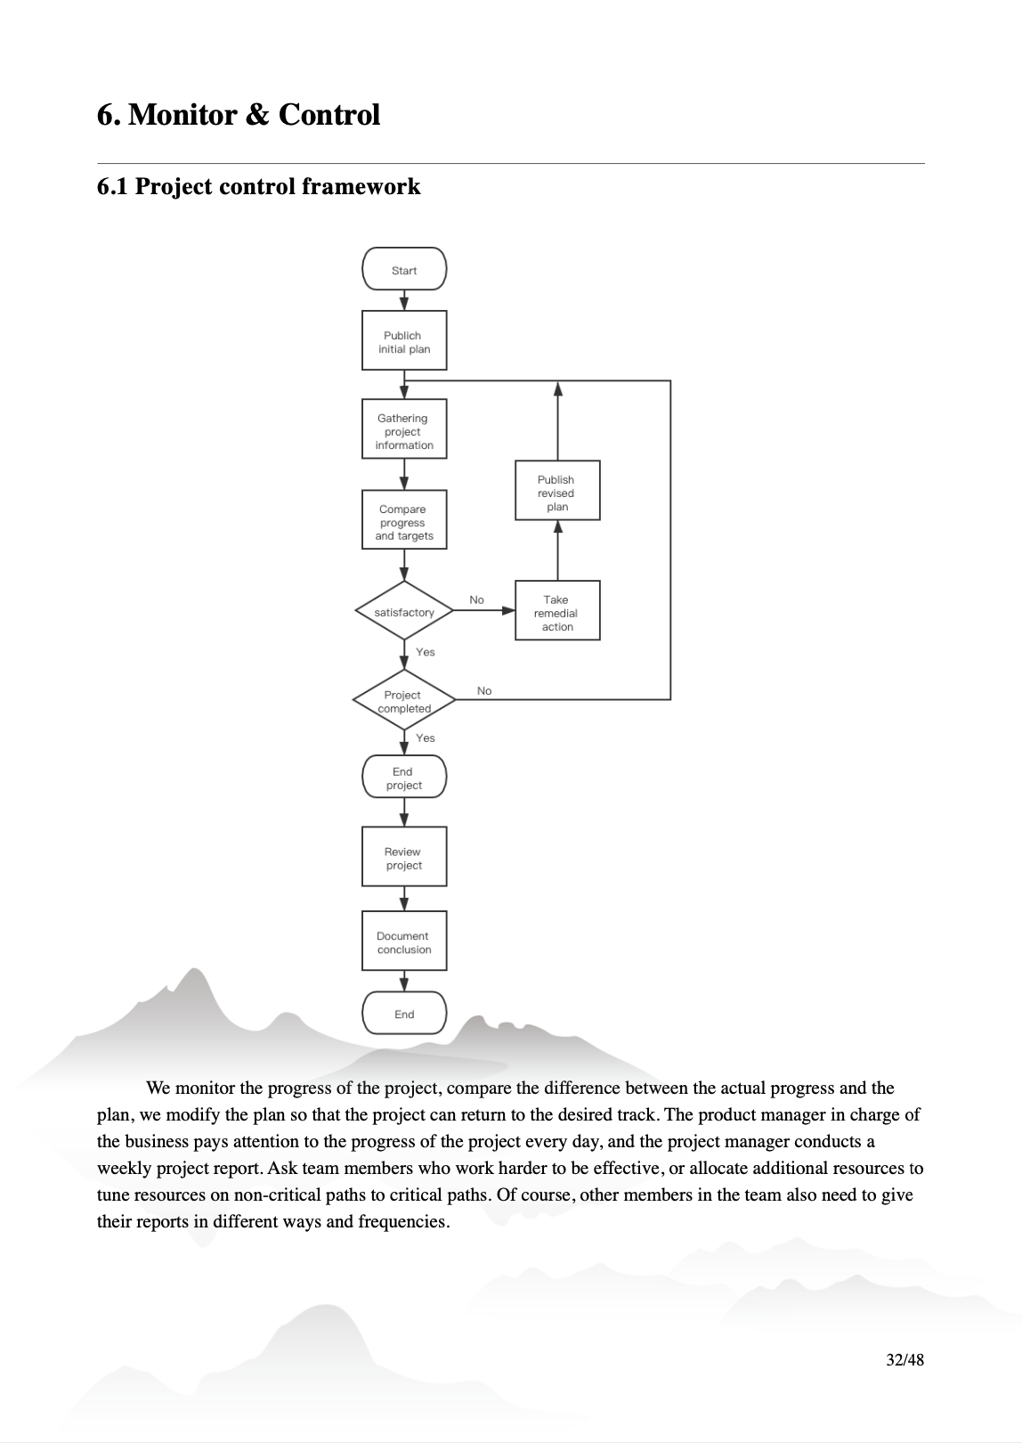
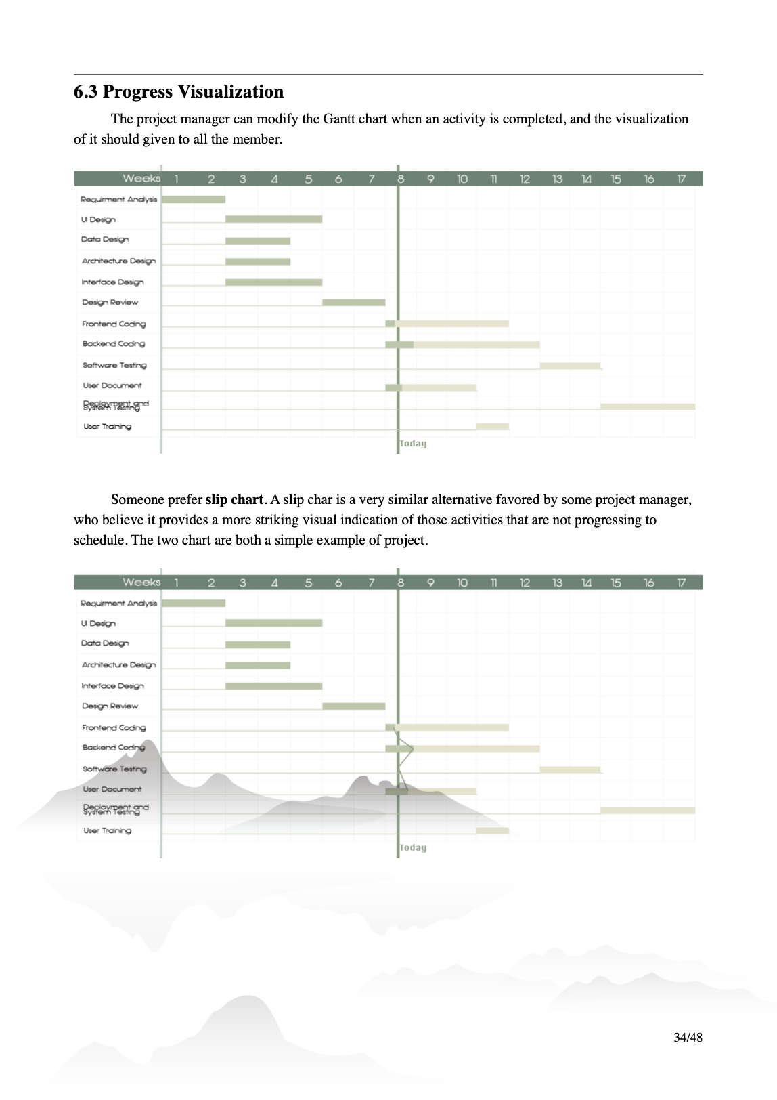
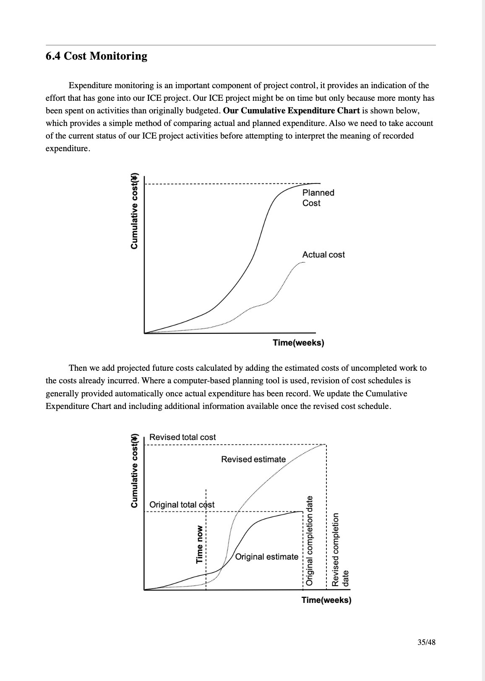
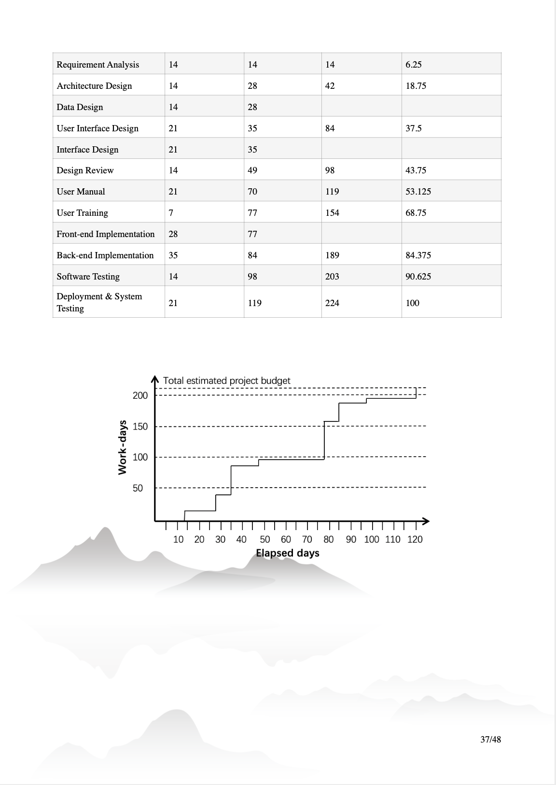
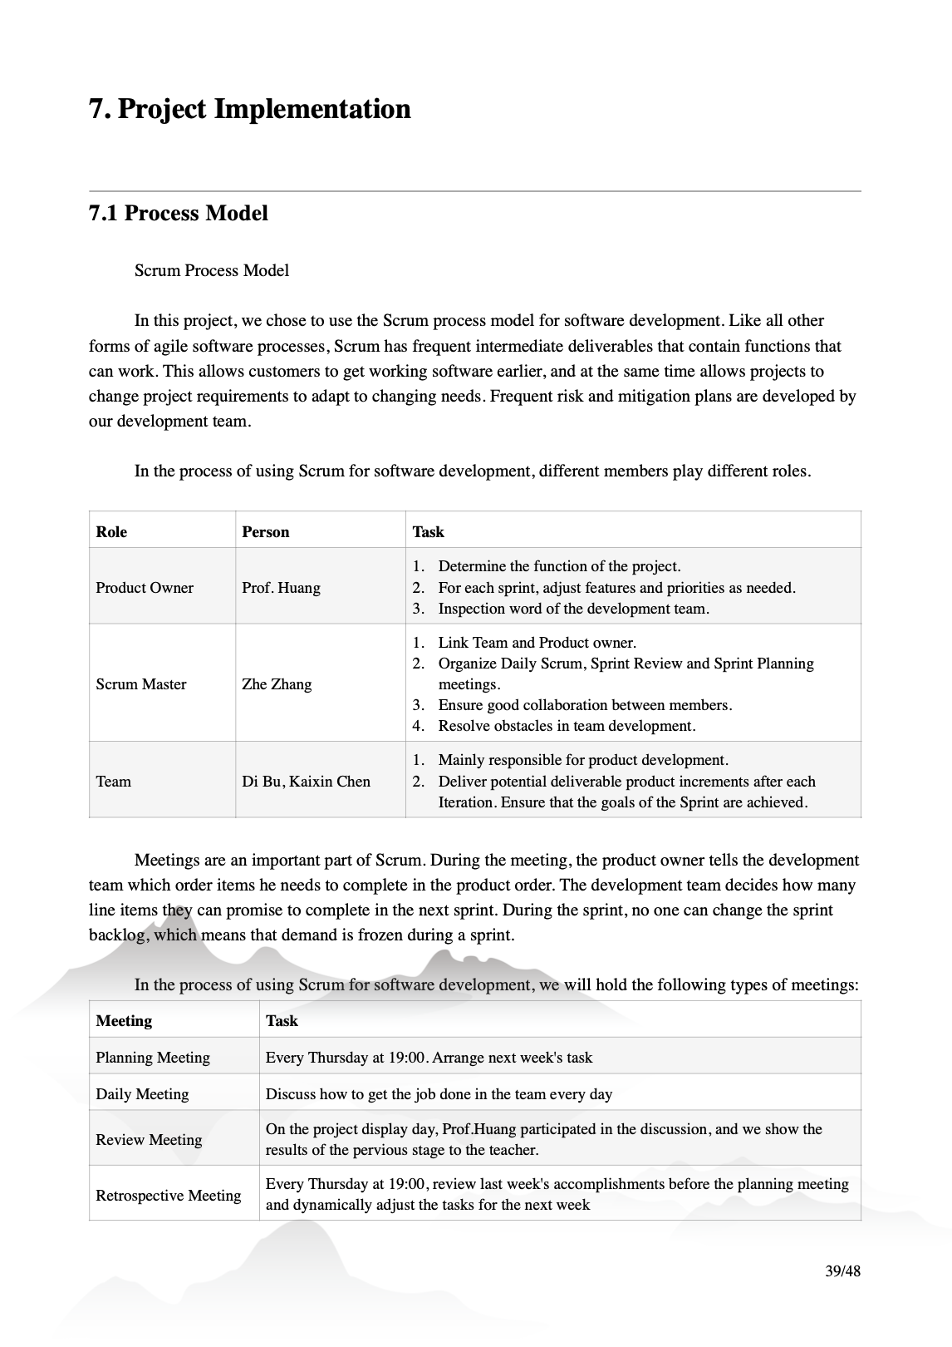





Slide 30




Slide 35






Slide 36


